Slide 1
TITLE
Notes:
Hi everyone!
Thank you for joining us and welcome to the third part of our ”Did you know” webinar series. This time we will be talking about “Developing Interfaces 101”.
In this session, we will explore a list of best practices for building interfaces that can help you to keep your Iguana channels running smooth and issue free down the road. Customers reach out from time to time if they experience downtime or performance issues on their servers. These hiccups could have been avoided using our best practices and we will review these today.

Slide 2
Focus
Tips Developing Interfaces
Better Design
Keep your interface running smoothly
Notes:
Today, we will focus on, one, Tips for developing interfaces, shedding light on topics that you may not know about.
Two, how to create better designs, focusing on scalability, performance, and reliability
And lastly, our overall goal with this session is to learn about how to keep your interface running smoothly

Slide 3
Agenda
01. Lua Programming
02. Database Integration
Why advanced coding?
How does Iguana runs scripts?
Use cases
Why database best practices?
Tips and tricks
Performance and reliability
Examples
03. Design Patterns
04. HL7 and Beyond Data Types
Why design patterns?
3 useful design patterns
Why non-hl7?
How to integrate?
CDA, X12, FHIR
Notes:
For the webinar’s Agenda, we will first explore Lua programming and cover how Iguana processes scripts.
Once we have an idea of how scripts are executed under the hood, we can apply these topics to our database integrations to speed up our database connectivity and implement reliable code
Understanding databases will lead us to our third topic, design patterns - where I will show you three different design patterns that will help your channels run smoothly.
And lastly, we will discuss our best practices on integrating non-HL7 datatypes.

Slide 4

01.
Lua Programming
Notes:
Without further ado, let’s start with out first topic! Lua Programming! So how many of you are familiar with Lua? Trick question! All of you should know Lua because Iguana scripts run it. But! Do you really know Lua and how its been implemented in Iguana?

Slide 5
Poll #1
How confident are you programming in Iguana?

Slide 6
Why Advance Coding?
Notes:
First thing’s first, why should we learn about advance lua coding and why is it important?

Slide 7
Why Advance Coding?
Process Messages Faster (Performance)
Notes:
A common request that we get is how to improve performance when messages are not processing fast enough. The main thing to ask is “Why are the messages processing slowly” and in most cases, there can be improvements made in the Lua coding.
Actually, let me share a story, when I first applied to iNTERFACEWARE, part of the interview was I had to make a sample interface using Iguana and Lua. And, I’m sure the developers in the call know, technical coding interviews are terrifying because the interviewer will point out everything wrong with your code, you have to code on the spot, and it is extremely nerve wracking. So, during the interview, I showed the interface I developed and the main question they asked was “How do you make it faster”.
And, I didn’t really understand the question, the code executed immediately, there is no need for it to go faster. But what I learnt was when you work with Iguana, it is different than simply executing a program and that is it. Your code is executed each time a message comes in. And thousands of messages can come in at a time, if your code takes even more than a second to execute, it might not be able to process have high traffic. That is why performance is important: to keep your interface stable and to ensure your messages are processed fast enough.

Slide 8
Why Advance Coding?
Process Messages Faster (Performance)
Easy Troubleshooting (Reliable)
Notes:
Advance coding is also great for troubleshooting. Understanding Lua errors and how your code is implemented will allow you to quickly find the root cause and resolve any production issues. This will ensure minimal downtime or prevent it altogether

Slide 9
Why Advance Coding?
Process Messages Faster (Performance)
Easy Troubleshooting (Reliable)
Do more with Iguana
Notes:
Lastly, learning advance coding will enable you to do more with Iguana. Once seemingly impossible tasks are now possible using coding techniques.
I will be covering three topics, and the first one is:

Slide 10
Did You Know?
Everything above main() executes once?
Notes:
Everything above main() executes once.
The main function is used in almost all programming languages including Lua. Normally a script would run from line 1 and down wards with the main function being the starting point, however, this works a little bit differently with Iguana and I will go over how the code is executed under the hood.

Slide 11
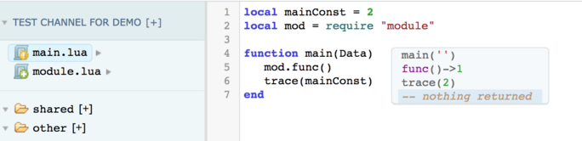
Did You Know?
Everything above main() executes once?
Notes:
Let’s have a look at this code, we have the main module on line 4. Above that, we have a constant and a require statement.
When the channel starts, the script will run

Slide 12
Did You Know?
Everything above main() executes once?
Notes:
From Line 1

Slide 13
Did You Know?
Everything above main() executes once?
Notes:
Then to line 2...

Slide 14
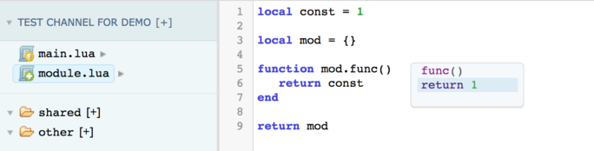
Did You Know?
Everything above main() executes once?
Notes:
Here, we go into module.lua and set const to 1 then jump back into main.lua

Slide 15
Did You Know?
Everything above main() executes once?
Notes:
And start executing the main function. On line 4-5 we call mod.func()

Slide 16
Did You Know?
Everything above main() executes once?
Notes:
Then execute line 5-7 of module.lua.

Slide 17
Did You Know?
Everything above main() executes once?
Notes:
Lastly, we end the script with line 6-7 of main.lua
All of this happens on the first time you START a channel. The key word being "Start". Let’s say now, the channel has been running and a message comes in to trigger this translator script. Now, the only lines that execute are

Slide 18
Did You Know?
Everything above main() executes once?
Notes:
Lines 4-5 from main.lua, we jump into module.lua and execute

Slide 19
Did You Know?
Everything above main() executes once?
Notes:
Lines 5-7 and finish the script by going back to the main

Slide 20
Did You Know?
Everything above main() executes once?
Notes:
On line 6-7 of the main.lua
When a new message comes in, only main.lua is processed and everything above the main is only executed once, on channel start up.
Here is another example

Slide 21
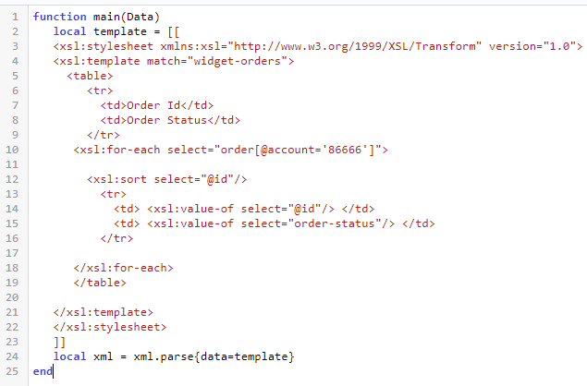
Did You Know?
Everything above main() executes once?
Notes:
This simplified example is based off a previous request where the customer wanted to improve the performance of their script. Let’s say, you have a template XML here and you want to parse it. You can see how inefficient this code is, every time a message comes in, the template has to be reassigned. A better implementation would be the following

Slide 22
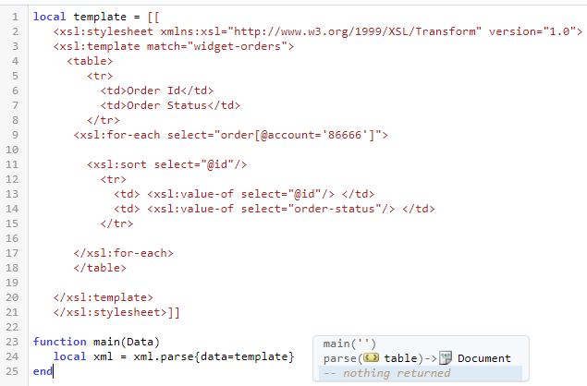
Did You Know?
Everything above main() executes once?
Notes:
Here, we have the template above the main. This template will get assigned once on channel startup. When messages comes in, the parsing can happen right away without the need to define the template every time. It might seem that this is a trivial enchantment, but when hundreds of messages are coming in every second, small changes like these can go a long way in keeping your channel running smoothly. We will talk about this more during the database topic, so keep this at the back of your mind!
Moving on, our next topic:

Slide 23
Did You Know?
You can create patterns in Lua strings?
Notes:
You can create patterns in Lua Strings. You may be familiar with regex in other programming languages. Lua uses patterns to achieve the same workflow.
Sometimes, when new data is received, you will need to extract certain information from strings and map that to your outbound message. Hardcoding or brute forcing your way through the string may work but this can cause performance issues or downtime down the road.
Instead, you can use patterns and our string API to keep your channels running smoothly.

Slide 24
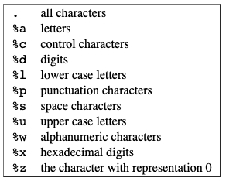
Did You Know?
You can create patterns in Lua strings?
Notes:
This is a table list of all character classes. You can use these to create useful patterns.

Slide 25

Did You Know?
You can create patterns in Lua strings?
Notes:
Here is an example where you use the character class percent D to create a pattern for the date. We can use string.find to find this pattern in the string and extract the substring date from it.

Slide 26

Did You Know?
You can create patterns in Lua strings?
Notes:
We can take this further, the capitalized version of the character class will represent the complement of that class. In this example, we use a capitalized percent A to represent all character OTHER than letters. Normally, lowercase percent A would represent only letter.
Here, we use gsub to replace the white space and the exclamation mark with an underscore.
Moving on, you can make patterns even more useful with modifiers for repetitions and optional parts.

Slide 27

Did You Know?
You can create patterns in Lua strings?
Notes:
Patterns in lua offer the four modifiers, plus, asterisk, dash, and question mark.

Slide 28
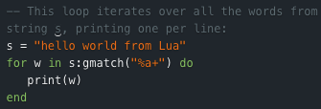
Did You Know?
You can create patterns in Lua strings?
Notes:
We have an example where there is a "for loop" that loops through each word in a string and prints the word. This is done with gmatch and the pattern “percent A plus”, which essentially means “A word”.

Slide 29

Did You Know?
You can create patterns in Lua strings?
https://help.interfaceware.com/api/#string
Notes:
You can get creative and the options are endless when it comes to patterns. We have many examples on our string API for further reading, but your best resource would be google. Simply search google for how you wish to manipulate a string in lua and a forum with either the answer or relevant information will come up. String manipulation is a common request and learning about patterns will help you with future development or improving existing code
Moving onto our next tip,

Slide 30
Did You Know?
How to Avoid Memory Leaks?
Notes:
How to avoid memory leaks
Anyone familiar with coding knows how annoying memory leaks are, thankfully, Lua will automatically handle garbage collection and memory management so there is no need to allocate memory yourself. However, due to the high throughput of messages that come in, translator scripts can be executed hundreds of times a seconds. Just a minuscule amount of leaking memory will lead to your server running out of memory after a few days. These leaks could be avoided if you follow our best practices and these tips.

Slide 31

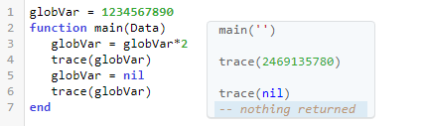

Did You Know?
How to Avoid Memory Leaks?
1
Global variables
Notes:
First we have global variables. All variables in lua are automatically assigned as global variables unless you put ‘local’ in front of its declaration. The misuse of global variables will cause a memory leak.
Here, you can see globVar is assigned as a global variable, as the channel runs, globVar will double in size until it is too large and causes memory issues.
Global variables do have their uses but please use them with caution. If you do use them,

Slide 32
Did You Know?
How to Avoid Memory Leaks?
1
Global variables
Notes:
Remember to assign nil to a global variable to remove it from memory. This helped one of our customers solve a memory leak they were having.
Moving onto our next tip,

Slide 33
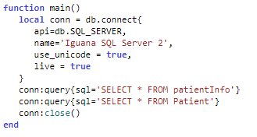
Did You Know?
How to Avoid Memory Leaks?
2
Not using Persistent Database Connections
Notes:
Not using persistent data base connections. A persistent database connection is a single connection that is re-used for all database queries. If you do not know what that means, don’t worry, we will go over the topic later in the database section.
For now, just look at this database connection here. If you receive high traffic, there will be a large number of database connections being opened and closed. This does not give the server enough time to close the previous connection before a new connection request is being made leading to a memory leak. To avoid this, we can use a persistent database connection and I will go into more details in our next topic. For now,

Slide 34
Recap
Notes:
Let’s recap what we learnt and tie it back to the main focus of this webinar, which is, how to keep your channels running smoothly

Slide 35
Recap
Everything above the main executes once
Notes:
We talked about how everything above the main executes once, its great to put constants or templates here so they don’t need execute each time the script runs. Of course, what you decide to put above the main is completely up to you and certainly not limited to constants or templates. We use this workflow to improve performance and increase the throughput of all your scripts. Next,

Slide 36
Recap
Everything above the main executes once
Patterns
Notes:
I showed how to use patterns with the string API. When extracting information from HL7 fields, some people use hard coded values or brute force their way through it. This works fine, but what if then the sending system, for whatever reason, decides to change the format slightly. Your script will either run into an error or your receiving system will get incorrect data. Using patterns will avoid this situation since you are looking for specific patterns within a string, rather than, for example, looking for a substring from position 5 to 10. Onto our last topic,

Slide 37
Recap
Everything above the main executes once
Patterns
Avoid Memory Leaks
Notes:
Avoiding memory leaks. Learning how to avoid memory leaks is crucial when keeping your interfaces up and running to avoid memory related crashes, we have an entire help document on avoiding memory leaks, for this session, I covered global variable and not using persistent database connection. I will talk more about database connections in our next topic:

Slide 38
02.
Database Integration
Notes:
Database integration!

Slide 39
Poll #2
Are you using databases with Iguana?

Slide 40
Why database best practices?
Notes:
Why should we learn about database best practices? Well, databases are one of the most commonly used API in Iguana and many customers have some form of database integration with Iguana. Databases become a key component with the overall architecture and customers want to ensure there are no problems with them. They want the database to be reliable.

Slide 41
Why database best practices?
Reliability
Notes:
Having a reliable database mainly refers to keeping the database connection alive. The connection can be destroyed from network issues, not enough database threads, or if database query is too large. If your database integration does not account for this, errors will be thrown and your channel will stop, leading to downtime. We will go into examples of how to keep your database integration reliable.
The other reason why we need to learn about database best practices is performance

Slide 42
Why database best practices?
Reliability
Performance
Notes:
One of the main bottlenecks in translator scripts is related to database connection and operations. If a customer asks how to improve performance, one of the first things I check is if they are using databases. I would then add Iguana logs before and after each database operation to pinpoint where exactly in the code it is acting slowly.
Most cases, people are not aware of our best practices for database integration and I will show some tips and tricks that have helped our customers keep Iguana running smoothly. With that, our first topic:

Slide 43
Did You Know?
You only need to connect to the database once per script?
Notes:
You only need to connect to the database once per script
One of the main downtime in database integration is connecting to the database. If a script takes a couple of seconds to connect to a database, the outbound message throughput can be slower than how many messages are coming in. If you only need to connect once to the database, this eliminate the problem. Let’s dive into an example

Slide 44
Did You Know?
You only need to connect to the database once per script?
Notes:
Here, I have my script, each time the translator executes, I connect to my database, do a couple of database queries, then close the connection. This is fine if you are not receiving a lot of messages, but when hundreds of messages are coming in every second, this implementation is too slow.
I had a someone with this exact problem, we setup log debug messages on each line of their code to see the exact part where in code it was taking the longest. And it was the database connection, which took about 3-5 seconds. This caused their queue of messages to be backed up since their output was slower than their input. They had their database connection within the main, and we can fix this by doing the following:

Slide 45
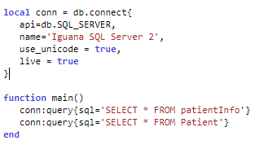
Did You Know?
You only need to connect to the database once per script?
Notes:
Back when I was talking about Lua coding, I mentioned that everything above the main will get executed once, on channel startup. Afterward, only the main function will get executed on each translator script.
Looking at this script, the connection is established once, when the channel starts, and it does not to be reconnected each time the script runs. When a message comes in, the only processing that happens are the two database queries. The connection also does not need to close since it will stay alive after the main executes, this is called a persistent database connection where a single database connection is re-used for all database queries. Referring back to my client whose database connection was impacting their performance. The moment they used a persistent database connections, each message processed 3-5 seconds faster, an instant improvement and their queue emptied in seconds.
There are some considerations to take when using persistent database connections. On some databases, you have a limited number of threads. Having a persistent connection will use one of those threads, and if you have multiple scripts that use this, you may run out of threads. Also, this implementation is great for high volume workflows, but it is not necessary for low volume. Lastly, you may have noticed, but the code right now is not reliable. If the database connection is closed or destroyed, the database queries will fail and Iguana will error out. To avoid this you will need to add connection retry logic, but….

Slide 46
Did You Know?
We have a module for retrying database connections?
Notes:
Did you know, we have a module for retrying database connections?
This module will check if the connection is alive before every database operation. To keep your channel running smoothly, you want to check for potential errors or failures in your code. As mentioned before, database connections can be destroyed from external factors on the network and you will need to check if the connection is alive to avoid errors in your script

Slide 47
Did You Know?
We have a module for retrying database connections?
Notes:
Here is our example from before, before we query the database, we need to implement some logic to check if the connection is alive and retry the database connection

Slide 48
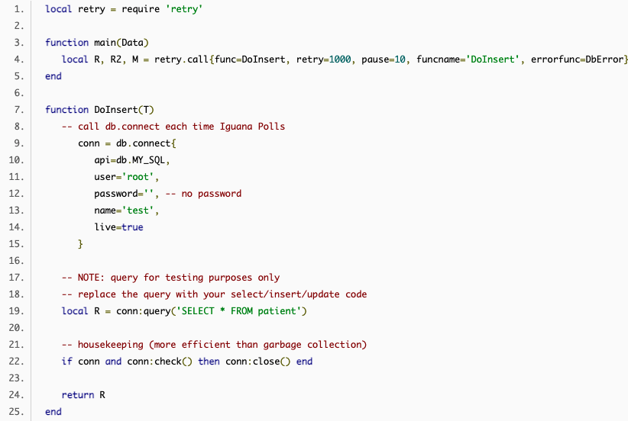
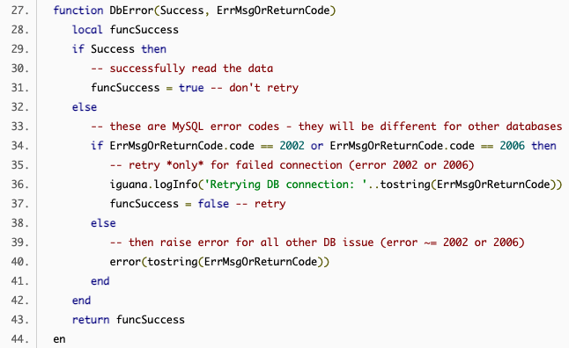
Did You Know?
We have a module for retrying database connections?
Notes:
We have complicated steps on how to do this in an old help document, but we have developed a better solution. Instead of adding this long code to your scripts, all you need to do is the following:

Slide 49
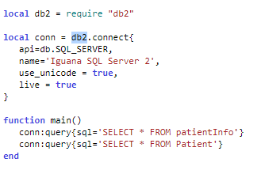
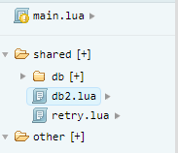
Did You Know?
We have a module for retrying database connections?
Notes:
Add the db2.lua module along with it’s require statement and change your db.connect to db2.connect. And it is that easy! So, what does the db2 module do? It will check the connection of the database, before every database operation, if the connection is closed or does not exist, it will retry connecting.

Slide 50
Did You Know?
We have a module for retrying database connections?
Notes:
You can configure the database retries in the db2 module, here we have the module will retry 100 times with 10 seconds between each attempt. Now let’s look at the database operation logic

Slide 51

Did You Know?
We have a module for retrying database connections?
Notes:
Here is the code for a db.execute, on the first line it will try to reconnect itself calling a ReConnect function

Slide 52
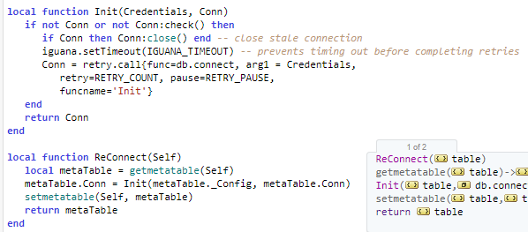
Did You Know?
We have a module for retrying database connections?
Notes:
This function will call another function called Init to check if the the connection is alive, if not then close the stale connect, and retry connecting based on the parameters we set before. All of these functions are made with the db2 module, so you do not need to worry about the specifics. The only changes in your code will be:

Slide 53
Did You Know?
We have a module for retrying database connections?
Notes:
Adding the db2 requires statement and changing db.connect with db2.connect. So, why should you add this? Many customers experienced production failures which could have been avoided if implemented db2. These errors mainly come up from the database connection being lost.
Most of the time, you will want to use db2 but of course, there are some considerations. Db2 and persistent database connections both require a database thread to be available. You can’t use this in a sqlite database since sqlite only uses a single thread whereas sql server can have uses multiple connection. Otherwise, I would suggest using db2 in almost every implementation.

Slide 54
Did You Know?
We have a module for retrying database connections?
https://help.interfaceware.com/v6/database-connection
https://github.com/interfaceware/support.git
Notes:
If you have any questions regarding this or would like to access the db2 module, you can visit our database connection help document. From there, you can import the example channel which includes the db2 module. Alternatively, you can get the source code for db2.lua and manually add it to a module from the help document here. If you have any questions, feel free to ask one of the support members on this call.

Slide 55
Recap
Notes:
Let’s review what we talked about

Slide 56
Recap
Persistent Database Connection
Notes:
Persistent database connections allow you to reuse a single database connection rather than opening and closing a new one each time the script runs. This is important in keeping your channels stable because opening a database connection can take up to 3 seconds, and if this needs to be done every time a message comes in, your queue will get backed up. Next,

Slide 57
Recap
Persistent Database Connection
DB2
Notes:
We talked about DB2, which is a module that checks if your database connection is alive before every database operation. Database connections can be closed from a network issue which will cause your database operation to fail and cause your channel to error out. To ensure your channel runs smoothly, you can avoid database connection errors using db2
Now that we know how to keep our database connections robust, let’s move onto our next topic

Slide 58
Did You Know?
You can cache database queries?
Notes:
You can cache database queries?
Why is it important-
Example – message mapping rules cache results for the mapping rules – talk to aryn
We covered improving performance with your database connection but what if the operation itself is slow. We have a module that will cache database queries so you will not need to query the database again for a set amount of time.

Slide 59
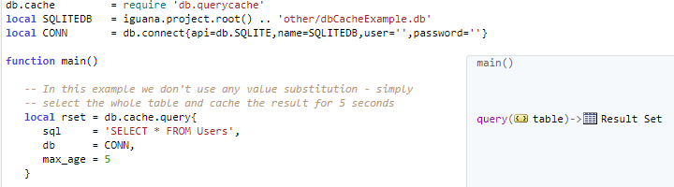
Did You Know?
You can cache database queries?
Notes:
In this example, we can query the database and get the result set rset. This set will be cached for 5 seconds, so anytime this code is encountered during that time, they will just get the cached value instead of referring to the database

Slide 60

Did You Know?
You can cache database queries?
Notes:
You can get a list of the cached sets and you can empty the cache as well

Slide 61
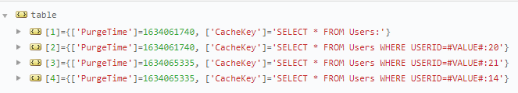
Did You Know?
You can cache database queries?
Notes:
Here we have 4 different queries and their respective purge times. We have a help document for this if you would like more information. This is a great tool to use if your workflow allows it. I had a customer that needed exactly this, they made a query call to a database and that information is relatively constant and changes maybe once every day at a fixed time. I suggested querying with our cacheing module and it improved their performance, especially since they were doing these queries in multiple different channels.
Moving away from coding now, we will move onto our next topic:

Slide 62
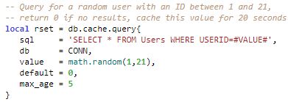
Did You Know?
You can cache database queries?
Notes:
You can also get creative

Slide 63
03.
Design Patterns
Notes:
Design Patterns, this refers to designing channels in a certain way to improve your workflow. In a previous webinar, we went over each design pattern already, so this section will cover three design patterns, and how they can be applied.

Slide 64
Why use design patterns?
Notes:
Now, why do we need to learn about design patterns? Improving your interface can go beyond just Lua code and using API, you need to think about the architecture as a whole and the main things that will get improved are:

Slide 65
Why use design patterns?
Scalability, Performance, Reliability
Notes:
Scalability, performance, and reliability. When customers are building complex interfaces that connect to multiple systems, these three factors are what they are looking for. Using a design pattern helped one of our customers reach their performance requirement. In another case, someone wanted their interfaces to be scalable and we suggested another design. These patterns all have one thing in common, and that is to produce …

Slide 66
Why use design patterns?
Scalability, Performance, Reliability
Clean Code
Notes:
Clean code that will modularize your interface. Creating a separation of concerns will help you in the future if you run into errors and need to troubleshoot. Our first design pattern will be:

Slide 67
Did You Know?
Channel Adapters
Notes:
Channel adapters. The general idea of the channel adapter is to

Slide 68
Did You Know?
Channel Adapters
1
Connects to an external application
Notes:
Connect to an external application

Slide 69
Did You Know?
Channel Adapters
1
Connects to an external application
Polls for or receives message
2
Notes:
Poll for or receives messages

Slide 70
Did You Know?
Channel Adapters
1
Connects to an external application
Polls for or receives message
Converts the format for channel queue
2
3
Notes:
Converts the format of the message for the channel queue

Slide 71
Did You Know?
Channel Adapters
1
Connects to an external application
Polls for or receives message
Converts the format for channel queue
Puts the message in the queue
2
3
4
Notes:
And puts the message in the queue

Slide 72
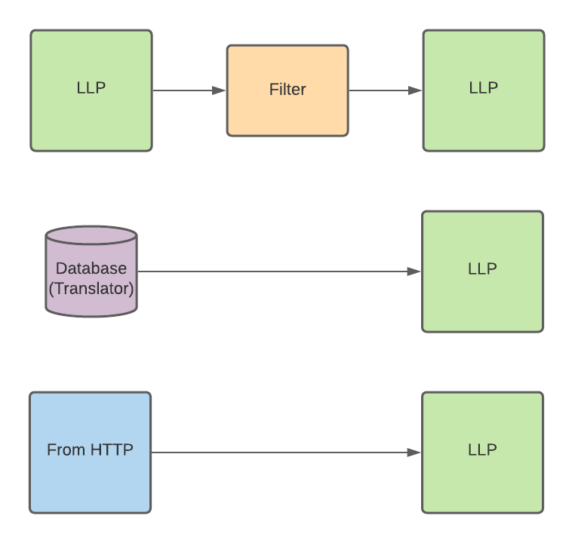
Did You Know?
Channel Adapters
Notes:
Here are example channel configurations. The adapter can get a message from the LLP, translator, or HTTP, and send it outbound to the channel queue via LLP. The purpose of Channel adapters are to be flexible enough to connect to any source system and scalable to reuse for all cases. Some examples are:

Slide 73
Did You Know?
Channel Adapters
Pros | Cons
Flexibility in connecting to any application | Performance Requires more processing steps
 | Reliability Introduced room for error in format conversion
 | Cost Increased coding effort
Notes:
Some pros and cons:
The main benefit would be the flexibility in connecting to any application and some cons would be performance, the code requires more processing, reliability, more room for error during the format conversion, and cost, there will be additional coding efforts.
Some uses cases that have helped our customers are
Do not talk about this

Slide 74
Did You Know?
Channel Adapters
EMR – AthenaHealth, EPIC
FHIR
Databases
Notes:
EMR adapters, from our previous webinar with Lianne, we went over building adapters to connect to AthenaHealth, Epic, and non clinical ones such as salesforce.
In that webinar, we explain how you can build your own adapters using the tools provided in Iguana. For EMRs, you can create custom VMDs and build your adapter using them or create an API adapter that generates a Lua object that contains all the key details. For more information, you can check out Lianne’s webinar as well as all our previous ones on our iNTERFACEWARE YouTube channel
You can also have a FHIR adapter to connect to any public fhir server, we have a great help document on Iguana acting as a FHIR client. And lastly, you can have a database adapter to map certain data into messages.
All in all, Adapters are a great way to improve your integration since it enables you to integrate with any source system smoothly. That leads us to our next design pattern

Slide 75
Did You Know?
Canonical Data Model
Notes:
The Canonical data model

Slide 76
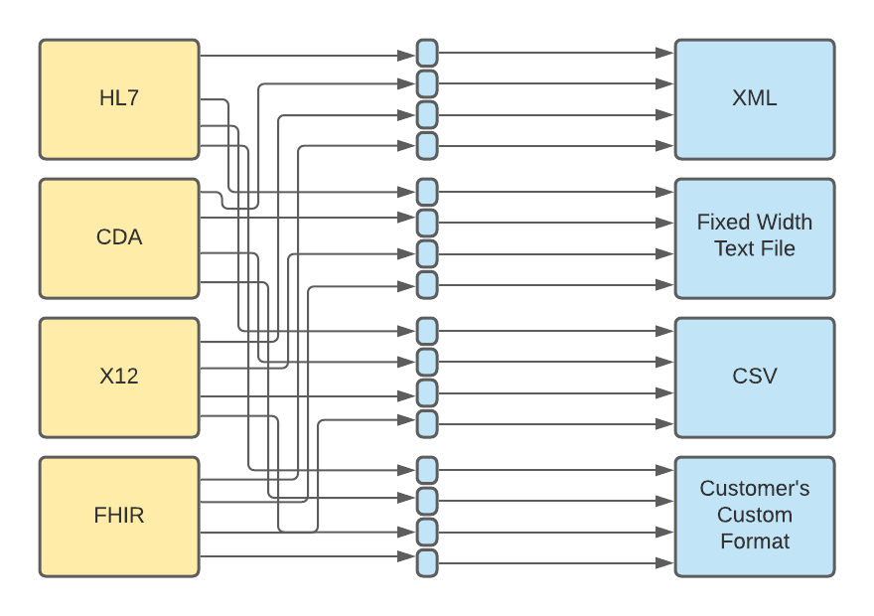
Did You Know?
Canonical Data Model
Notes:
Let’s say you have several incoming data types, and you need to convert them to an outgoing format. For example, we have HL7, CDA, X12 and FHIR coming in and they all need to be converted into XML, Fixed Width, CSV, and a Custom Format. You can see how messy this is and how many channels you would need. It gets even more complicated if we add a new formats.
Instead of this, we can have something like this

Slide 77
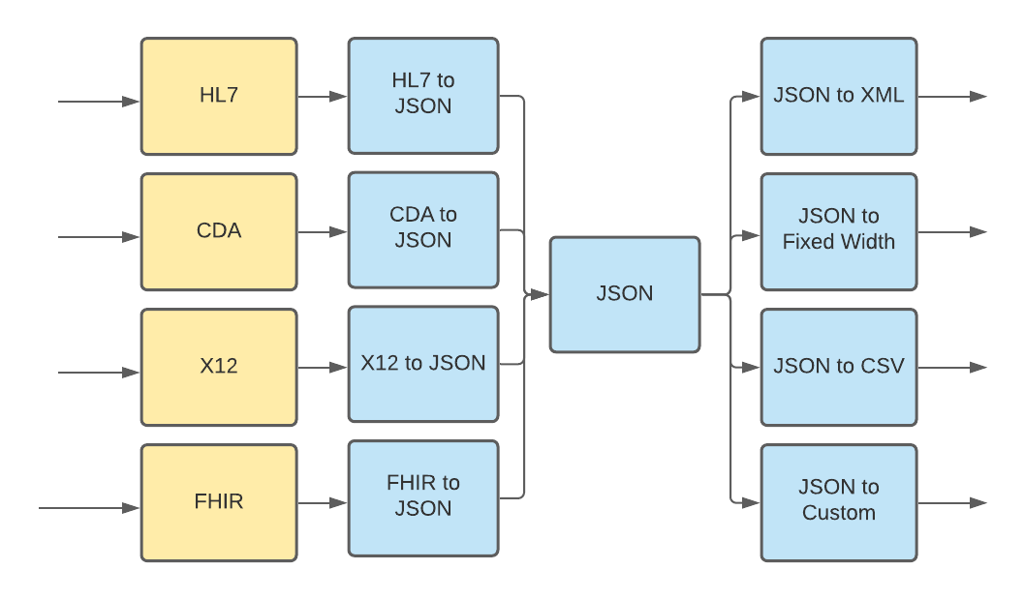
Did You Know?
Canonical Data Model
Notes:
Here, we have the canonical data model where we will convert all incoming data formats into one format, in this case, JSON. Then each outbound format will convert from JSON. This eliminates the need for all the channels and decreases complexity. The benefits may not appear great now, but if you have 10 or more formats, you will instantly notice that the canonical data model works well. A customer once approached us asking if it was possible to send messages from their database to X12. They required scalability for developing other x12 data formats and we proposed the canonical data model to them. This would allow their interface to smoothly implement future X12 data formats.
Moving on, our last design pattern is

Slide 78
Did You Know?
Canonical Data Model
Pros | Cons
Scalability Easy to add/replace new interfaces Helps resolve format discrepancies | Performance Increased processing; unsuitable for very high throughput systems
Maintenance Fewer mappings to be generated when adding/removing interfaces Fewer mappings to modify if a system changes (e.g. database adds a column) Reduces connectivity testing requirements when adding/modifying interfaces | Initial cost (time, resources) More initial effort to implement, particularly in mapping and documentation Increased log usage in Iguana
Notes:
Let’s go over some pros and cons for this design pattern. Some benefits, scalability, its easy to add and replace new interfaces and the maintence is less since there are fewer mappings. Some cons are performance, increased processing and is unsuitable for high thoughput systems. The initial cost to develop this model is expensive.
Moving onto our last design pattern.

Slide 79
Did You Know?
Claim Check
Notes:
Claim check. A common case that comes up is an HL7 messages comes in that have large files attached to it. Instead of processing the message as is. You can:

Slide 80
Did You Know?
Claim Check
1
Receives a message with large data
Notes:
Receive the message

Slide 81
Did You Know?
Claim Check
1
Receives a message with large data
Remove the large data and replace with an ID
2
Notes:
Remove the large data and replace it with an ID

Slide 82
Did You Know?
Claim Check
1
Receives a message with large data
Remove the large data and replace with an ID
Store the data in a data store
2
3
Notes:
Store the data in a data store

Slide 83
Did You Know?
Claim Check
1
Receives a message with large data
Remove the large data and replace with an ID
Store the data in a data store
Swap the ID and data after processing
2
3
4
Notes:
Then after all the processing, swap the ID for the data. Here is an example of this:

Slide 84
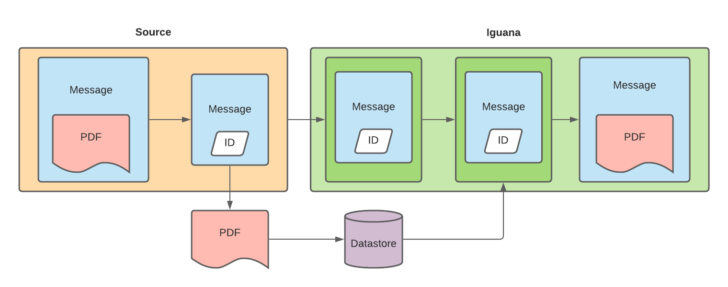
Did You Know?
Claim Check
Notes:
We had a customer whose CPU usage was too high and their logs size were exploding. This was because they were receiving messages with a PDF up to 500MB large. Each time the message was parsed, the large pdf was also parsed, and this workflow could be handled better.. We suggested the claim check design and their source system was able to separate their PDF and SFTP it to their production server. The message had the pdf replaced with a file name. After processing the message in Iguana, the file name was replaced with the PDF then sent outbound.
This eliminated the unnecessary parsing of the PDF in several channels. Their CPU usage and outbound message rate improved drastically. Their entire environment use to be unstable before this design pattern was introduced and now, it is running smoothly.

Slide 85
Did You Know?
Claim Check
Pros | Cons
Performance Ensures only the necessary data is passed on | Maintenance Requires additional maintenance to clean up the external storage Need to handle lost data
Reliability Improves Iguana’s reliability by reducing the impact on the logs | Cost (time and resources) Requires setting up the external storage
Notes:
Some pros and cons. Pros: Perfornace of the server will have an overall improvement and the logs will have less imact, making Iguana reliable and less suseptable to out of memory issues. Cons: Maintence, you will need to clean up the data store and handling lost data will be a consideration. Cost, requires setting up external storage.
That concludes our last design pattern finally, we have our last topic
- Can remove this-

Slide 86
Recap
Notes:
To summarize what we talked about:

Slide 87
Recap
Channel Adapters
Notes:
You can use channel adapters to connect to any source and push the received information to the channel queue. We have all the tools in Iguana for you to start creating your own adapters and its important spend time creating clean code that can be used for all use cases. This will enable smooth integration with any source system.

Slide 88
Recap
Channel Adapters
Canonical Data Model
Notes:
Next, we talked about a way to convert data from many incoming formats to many outgoing formats using the canonical data model. This improves scalability when adding new data formats and simplicity for future development. If you run into an error, you can easily find where the problem is happening because the canonical data model will severally decrease your number of scripts.

Slide 89
Recap
Channel Adapters
Canonical Data Model
Claim Check
Notes:
Finally, we talked about claim check which remove a large file from an incoming message to decrease the processing required in Iguana. This will keep your log sizes and CPU usage low to ensure your server is stable.
That covers all of our design patterns, and now, we will go ahead and talk about our final topic, which is:

Slide 90
04.
HL7 and Beyond
Notes:
HL7 and beyond, now that you have experience developing with HL7, we will explore how to tackle non-HL7 data types

Slide 91
Poll #3
Have you or are you interested in integrating
with non HL7 data types?

Slide 92
Why non-HL7?
Notes:
So, why non-HL7 and why is it important?

Slide 93
Why non-HL7?
Iguana can process any data type
Notes:
Iguana can process data types other than HL7

Slide 94
Why non-HL7?
Iguana can process any data type
Healthcare Industry Trends
Notes:
The Healthcare Industry is always changing and to meet new trends, Iguana is built to integrate with all data types. This is important for meeting vendor requirements

Slide 95
Why non-HL7?
Iguana can process any data type
Healthcare Industry Trends
Vendor Requirements
Notes:
While setting up a new vendor, some customers reach out for help handling data types they are unfamiliar with. The goal of this section is to show our best practices for integrating three popular non-HL7 data types.
Our main focus will be on the following:

Slide 96
Did You Know?
Iguana can integrate with any data format
1
Moving Data
Parsing
Building Messages
Mapping
2
3
4
Notes:
Moving Data, Parsing, Building Messages, and mapping. These four steps are important when considering data types. Our first data format will be CDA.

Slide 97

Did You Know?
CDA can be integrated with Iguana
Notes:
CDA can be integrated with Iguana. CDA is an XML-based standard for encoding clinical documents. To integrate with iguana,

Slide 98
Did You Know?
CDA can be integrated with Iguana
1
Sending Data
HTTP LLP SFTP Database
Notes:
First, we can send and receive data in many ways, mainly HTTP, LLP, SFTP, or from a database. Some CDA connectors use SOAP and HTTP to send and receive messages. For LLP, you can establish persistent connection between servers for reliable data flow and If your message is large, SFTP is the best way to receive them. Lastly, messages can be stored and queried in database to enable specific SQL queries on them.
Moving onto parsing,

Slide 99

Did You Know?
CDA can be integrated with Iguana
2
Parsing
Notes:
Since CDA is XML based, you can parse messages using xml.parse,

Slide 100
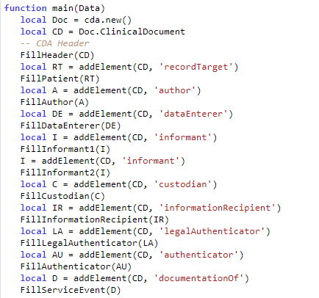
Did You Know?
CDA can be integrated with Iguana
3
Building Messages
Notes:
To build the message we have our CDA API. Here in this sample code, I create a new CDA document using cda.new and I populate the fields of the clinical document. We have an excellent example of this in our help document for more information.

Slide 101
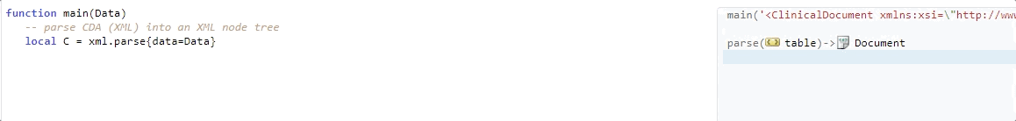
Did You Know?
CDA can be integrated with Iguana
4
Mapping
Notes:
Lastly, to map, you can use the annotations provided from the Iguana Translator to find the xml element you are looking for. Here, I can find the node for the Custodian Organization name and I map the name ‘General Hospital’. Once again, we have this heavily documented on our help site. Next,

Slide 102
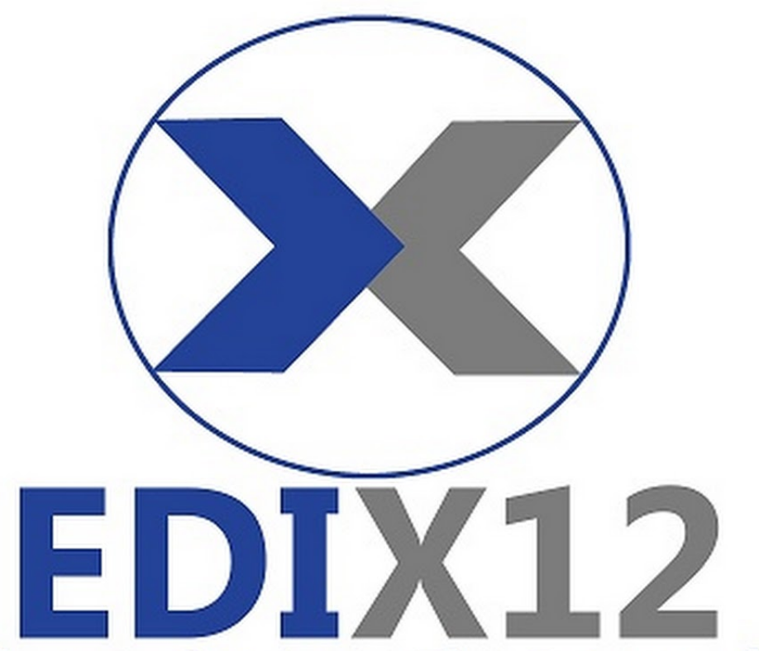
Did You Know?
X12 can be integrated with Iguana
Notes:
X12 can be integrated with Iguana. X12 is a format for Electronic Data Interchange or EDI and is used for the exchange of business documentation. Similar to CDA, we can

Slide 103
Did You Know?
X12 can be integrated with Iguana
1
Sending Data
HTTP LLP SFTP SMTP Databases
Notes:
Send and receive data via HTTP, LLP, SFTP, and databases. For EDI, SMTP is legacy support and not commonly used in health care. Web services or HTTP is used for real-time communication, and FTP is used commonly for EDI, mainly for batch processes and large data size.

Slide 104
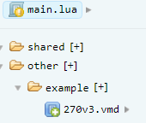

Did You Know?
X12 can be integrated with Iguana
2
Parsing
Notes:
To parse X12 in Iguana,, it is similar to HL7. You can use our x12 API to call x12.parse and you will need an x12 VMD for the specific version and type. Here, we have x12 270 version 3

Slide 105
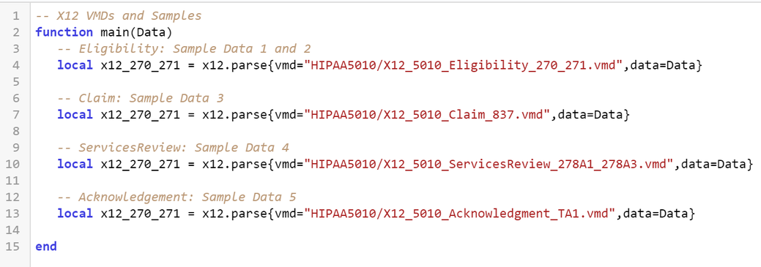
Did You Know?
X12 can be integrated with Iguana
2
Parsing
Notes:
Here is another example with multiple different vmds, we have eligibility, claim, servicesReview, and Acknowledement. Moving on,

Slide 106

Did You Know?
X12 can be integrated with Iguana
3
Building Message
Notes:
To build the message, similar to hl7, you will do x12.message to create an outbound message, this message can be used for mapping

Slide 107

Did You Know?
X12 can be integrated with Iguana
4
Mapping
Notes:
And to map, you can use the auto annotations to get the specific field and assign a value accordingly. Here I set the Authorization Information Qualifier to 00

Slide 108
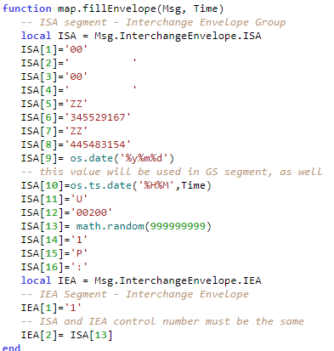
Did You Know?
X12 can be integrated with Iguana
4
Mapping
Notes:
You can take this further by creating function for filling segments. We have lots of examples in our help document that you can refer to. Overall, X12 is roughly the same steps as HL7 where you have VMDs for each type of message then use our x12 API to parse and build a message.
Moving onto our last topic,

Slide 109

Did You Know?
FHIR can be integrated with Iguana
Notes:
FHIR can be integrated with Iguana. As healthcare trends are changing FHIR is becoming more popular. The basic building blocks of FHIR is a resource, and all exchangeable content is defined as a resource

Slide 110
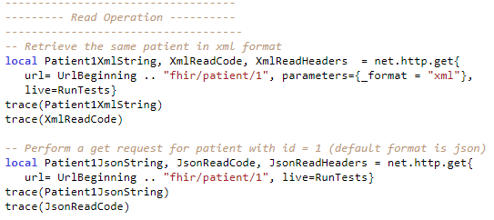
Did You Know?
FHIR can be integrated with Iguana
1
Sending Data
Notes:
To send data with FHIR, Iguana will act as the FHIR client and send web requests to the FHIR server. Here, we are using net http get to do a read operation on the FHIR server to receive data. To send data, you will do a post request.
Notice how you can specify the format from XML or JSON.

Slide 111
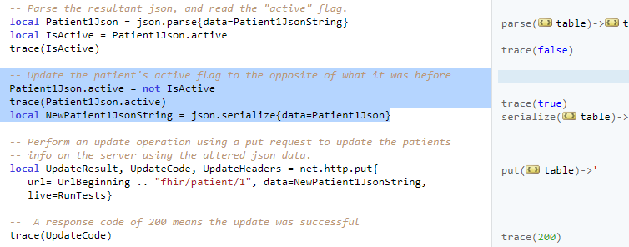
Did You Know?
FHIR can be integrated with Iguana
2
Parsing
Notes:
Once you receive the data, you can parse it and change its content. Here I parse the data using the json,parse and switch the patient’s active flag, serialize the json, and update the FHIR server with net http put.

Slide 112

Did You Know?
FHIR can be integrated with Iguana
3
Building Message
Notes:
To build a message, you will need to build the FHIR resource and populate each field. Here, I have the patient resource template created in one of my profiles. I assigned the variable patient with my patient resource profile to build the message.

Slide 113
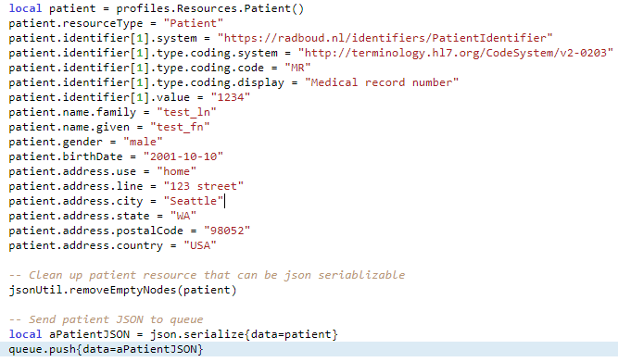
Did You Know?
FHIR can be integrated with Iguana
4
Mapping
Notes:
To map,I populate the resource I created. Once done, I clear the empty nodes that were not used and serialize the JSON. And that about covers all the steps for FHIR!
Using our API, Iguana can act as a FHIR client and seamlessly integrate the two.

Slide 114
Recap
Notes:
To recap this topic, we talked about:

Slide 115
Recap
CDA
Notes:
CDA, since it is an XML-based format, we can use our xml API to parse the message and map the fields accordingly.

Slide 116
Recap
CDA
X12
Notes:
For X12, the process is similar to HL7, where you use a VMD to parse and build a message. This is all done with our x12 API. Lastly,

Slide 117
Recap
CDA
X12
FHIR
Notes:
For FHIR, we showed how Iguana can act as a FHIR client where it can receive and send information via HTTP requests. You can build a FHIR resource using a template and map data accordingly.
All the lessons learnt for integrating with these three apply all to data types. Whether it is CSV, SOAP, JSON, or XML, you can use our API to parse the message and you can build the message using a template. Now that you know our best practices for developing non-hl7 interfaces, you can start integrating different datatypes smoothly to avoid future errors.

Slide 118
Conclusion
Notes:
And finally, we have reached the end of our webinar! To summarize, we talked about the Lua Programming, Database Integration, Design Patterns, and non-HL7 data types. I highlighted why these topics are important and how they can keep your Iguana running smoothly. I hope that everyone here learnt something today
If you have any questions regarding the topics related to this webinar, feel free to reach out to our support team and we are happy to help!

Slide 119

Thank You!
Notes:
Thank you again for joining us in our webinar and I hope to see you again in the next one!

