Slide 1



DID YOU KNOW?
Part 1: Doing More With Iguana

Slide 2
Agenda
Iguana Configuration and Administration
Installation
Licensing
Deployment
Upgrade/Migration
Configuration Management
Troubleshooting/Debugging
Security
Performance Testing
Developing Interfaces
Interface Designs
Hidden Lua Commands
HL7 and Beyond
Database Integrations
Solutions and Workflows
Templates

Slide 3
INSTALLATION

Slide 4


Installation
Notes:
Download

Slide 5

Installation
Notes:
Configure

Slide 6

Installation
Notes:
Create interfaces

Slide 7

Installation
Did You Know?
Creating Iguana.exe packages
Notes:
Package into EXE

Slide 8

Installation
Application Files
Notes:
Stored in a set of directory files:
Application files: dashboard, being able to turn channels on and off

Slide 9
Installation
Application Files
Configuration Files
Notes:
Configuration files: configuration settings, environmental variables, and external repository configurations

Slide 10
Installation
Application Files
Configuration Files
Log Files
Notes:
Logged Iguana interactions

Slide 11
Installation
Iguana.exe
Build Once and Export
Application Files
Configuration Files
Log Files
.EXE
Notes:
Executable = build and configure once, then export
OEM (Original Equipment Manufacturer) applications.

Slide 12
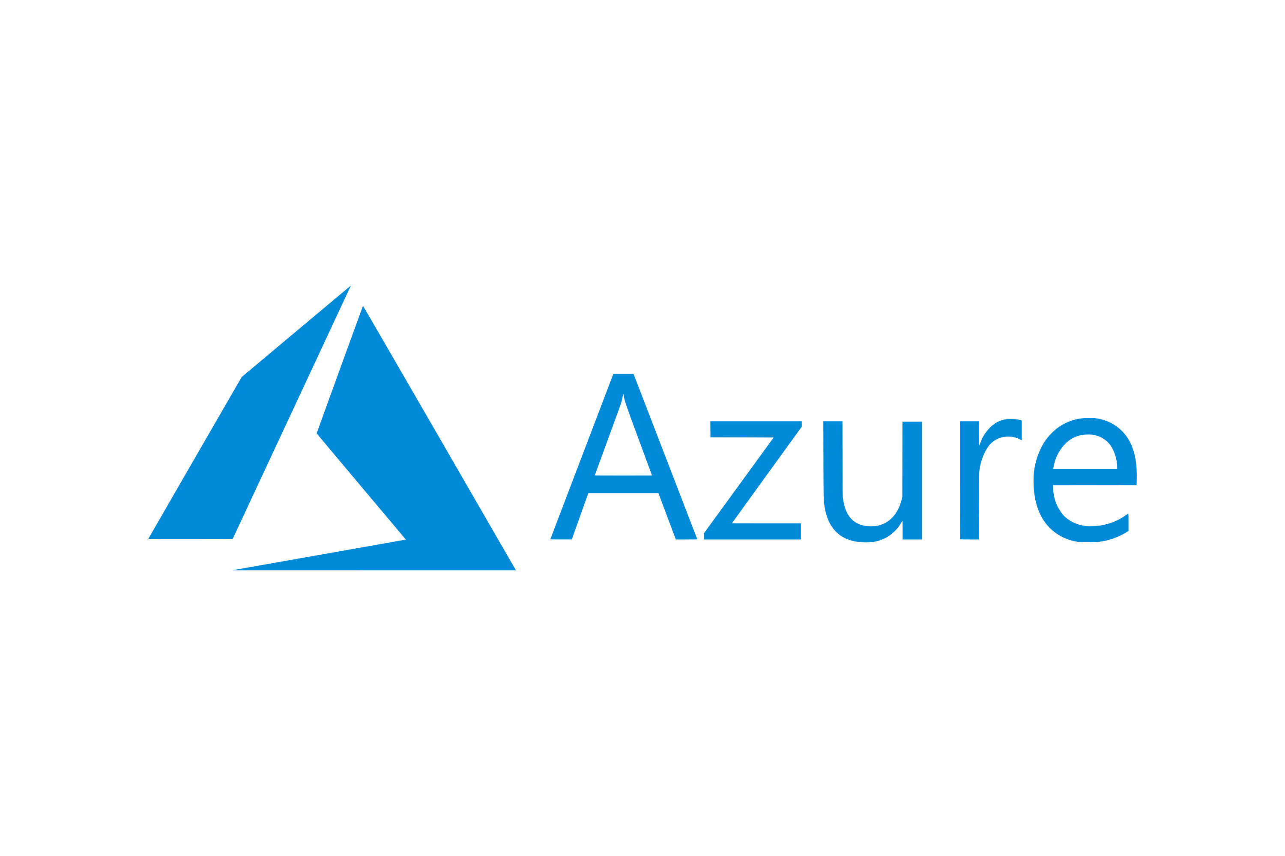

Installation
10 minutes to configure . 2 hours to deploy . 1,000 resources/second.
on
Notes:
Iguana web service using a FHIR-based API.
Azure 10 minutes, Iguana
capable of processing 1,000 FHIR resources per second
on a FHIR sever,
within about 2 hours.

Slide 13

Installation
Iguana.exe Benefits
Less Development . Fast Time-To-Market . Improved Scalability
Notes:
less time on development
achieve a faster time-to-market with your instances (Due to the quick deployment process),
improve your scalability efforts through auto-deployment
Next - “Did You Know” Administration webinar

Slide 14
LICENSING
Notes:
Register and license your Iguana.
A requisite for activating your instances.

Slide 15
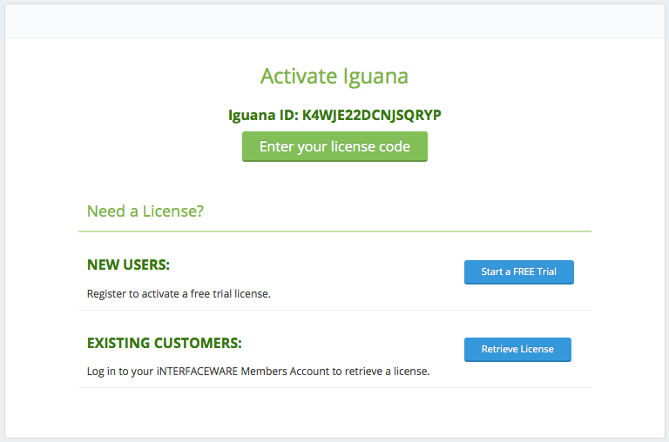
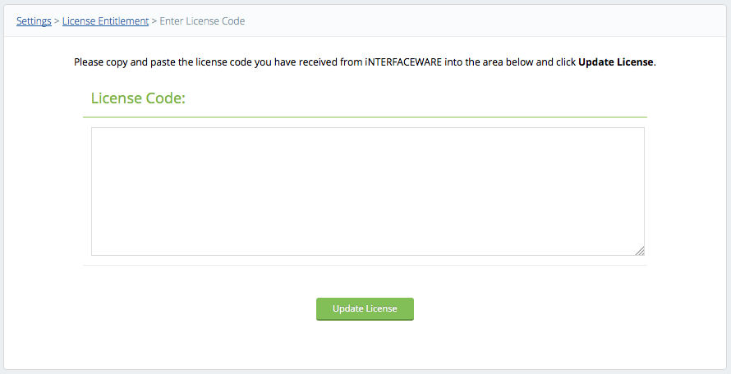
Licensing
Licensing Process
ABCDE12345ABCDE12345ABCDE12345ABCDE12345ABCDE12345ABCDE12345ABCDE12345ABCDE12345
ABCDE12345ABCDE12345ABCDE12345ABCDE12345ABCDE12345ABCDE12345ABCDE12345ABCDE12345
ABCDE12345ABCDE12345ABCDE12345ABCDE12345ABCDE12345ABCDE12345ABCDE12345ABCDE12345
ABCDE12345ABCDE12345ABCDE12345ABCDE12345ABCDE12345ABCDE12345ABCDE12345ABCDE12345
ABCDE12345ABCDE12345ABCDE12345ABCDE12345ABCDE12345ABCDE12345ABCDE12345ABCDE12345
ABCDE12345ABCDE12345ABCDE12345ABCDE12345ABCDE12345ABCDE12345ABCDE12345ABCDE12345
ABCDE12345ABCDE12345ABCDE12345ABCDE12345ABCDE12345ABCDE12345ABCDE12345ABCDE12345

Slide 16
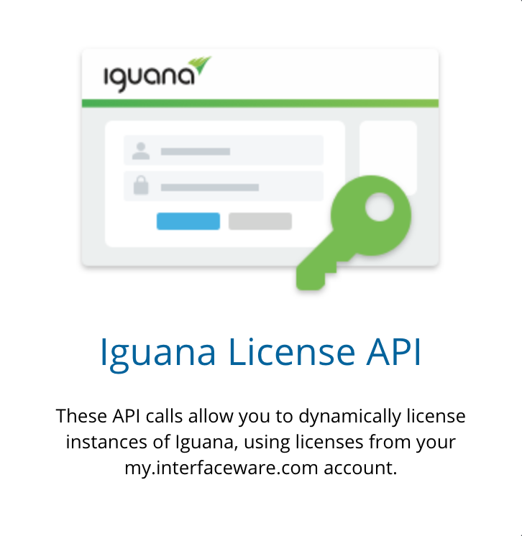
Licensing
Did You Know?
Using the License API
Notes:
Automatically activate new instances, or transfer licenses

Slide 17
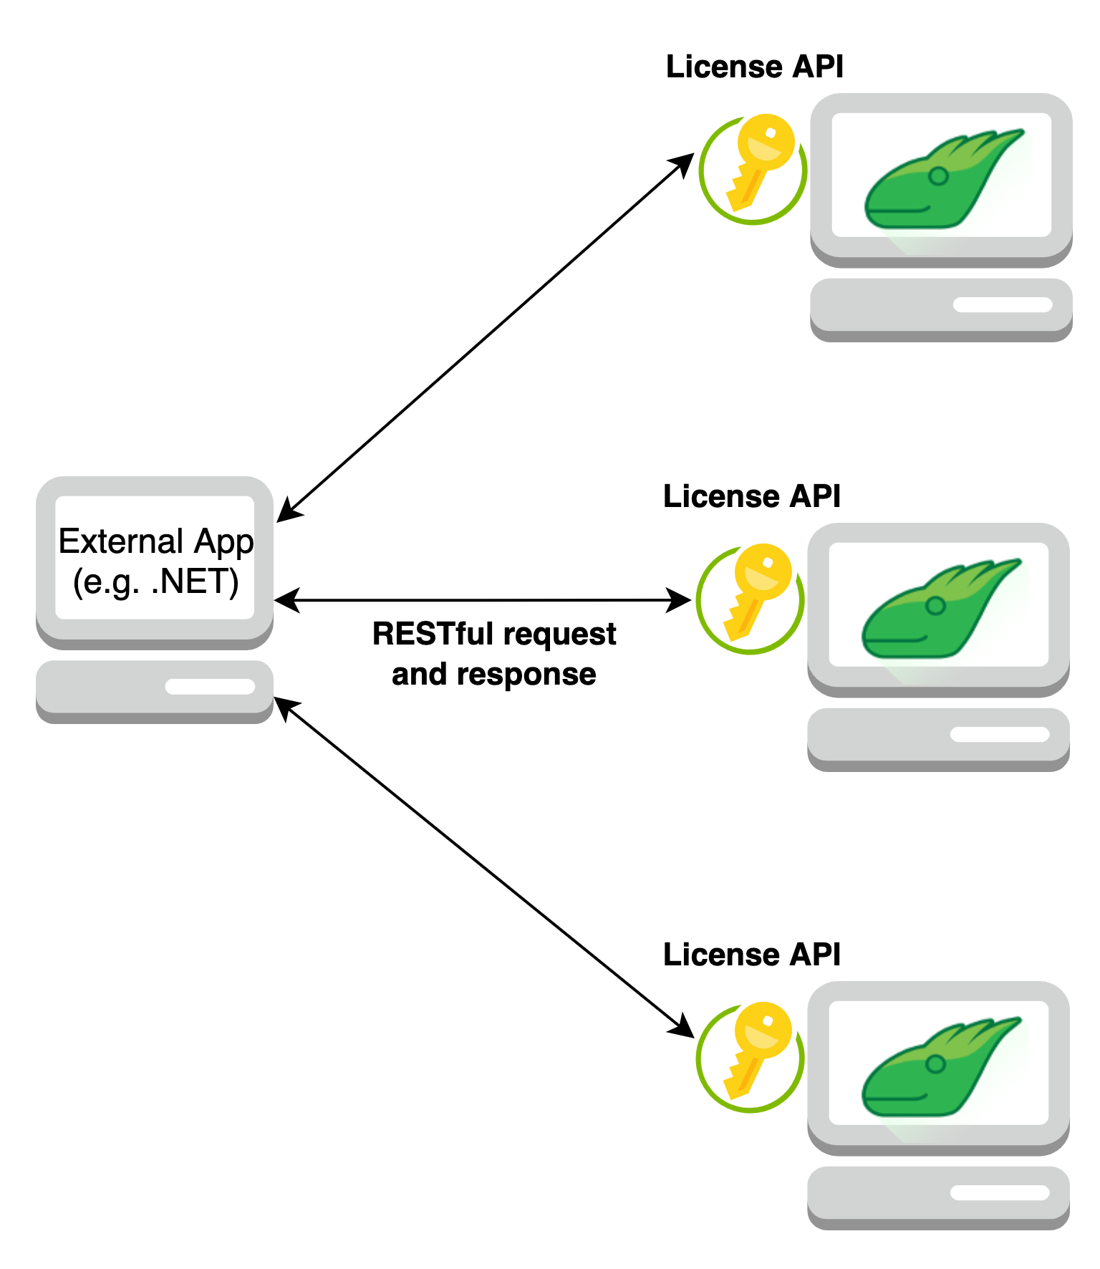
Licensing
Notes:
A fleet of Iguanas that need to have...

Slide 18

Licensing
Notes:
Their licenses activated...

Slide 19
Licensing
Notes:
or transferred,

Slide 20
Licensing
Notes:
migration process

Slide 21

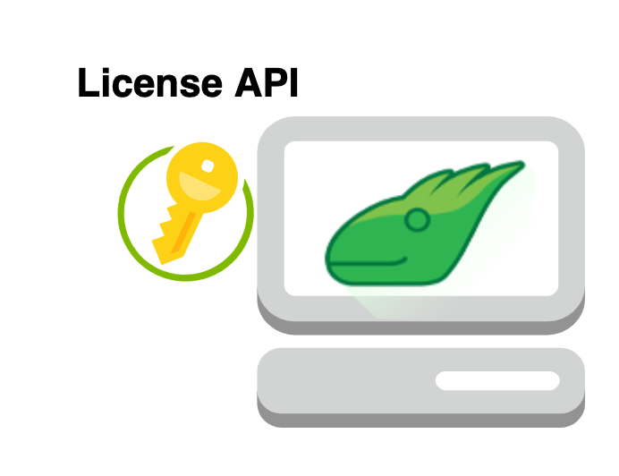

Licensing
Notes:
Iguana servers goes down

Slide 22

Licensing
Notes:
get back up and running with your secondary or redundant instances.
call this API through any external application
Complete flexibility of use

Slide 23
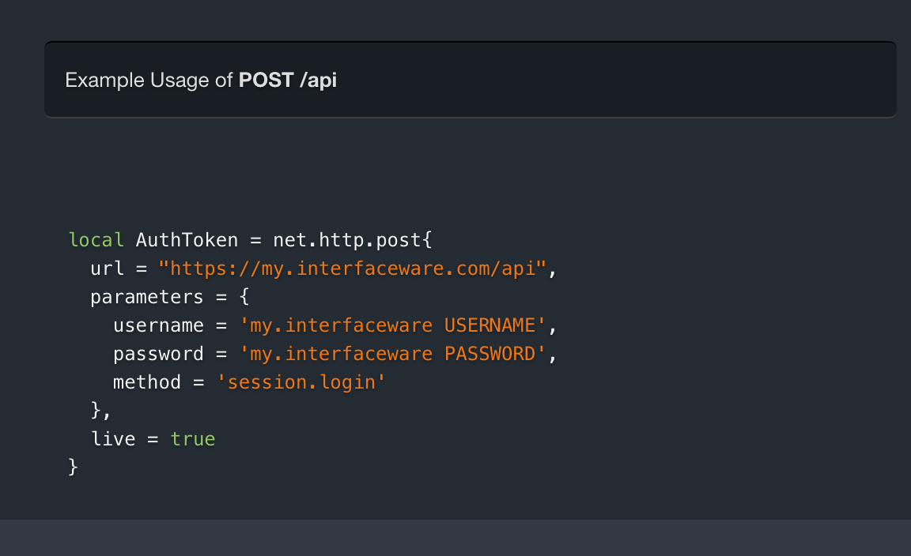
Licensing
License API
Get authorization token
Get list of licenses
Activate a license
Check if a license is activated
Transfer a license
Get instance details
Apply license
Notes:
Access to several license-based activities
Getting an authorization token,

Slide 24
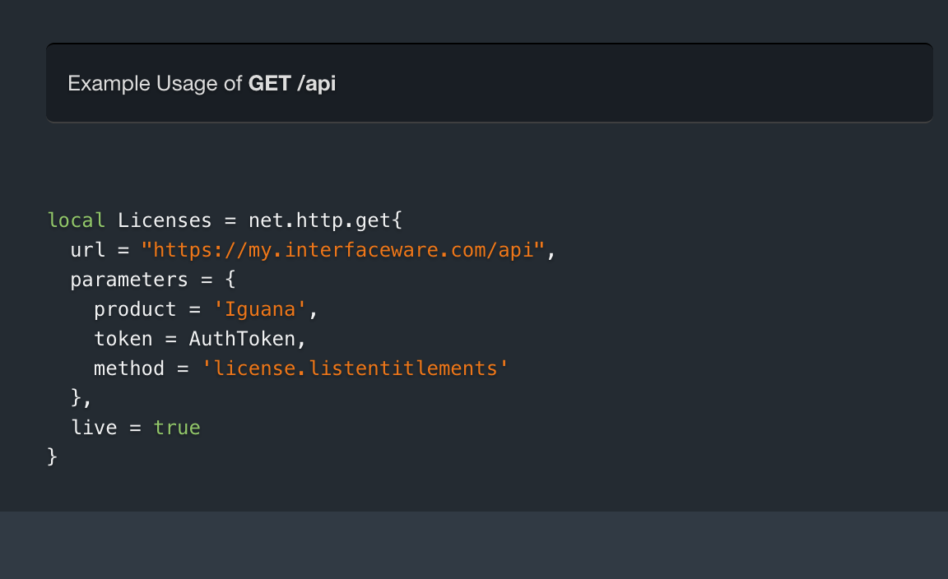
Licensing
License API
Get authorization token
Get list of licenses
Activate a license
Check if a license is activated
Transfer a license
Get instance details
Apply license
Notes:
Getting a list of available license codes from your account

Slide 25
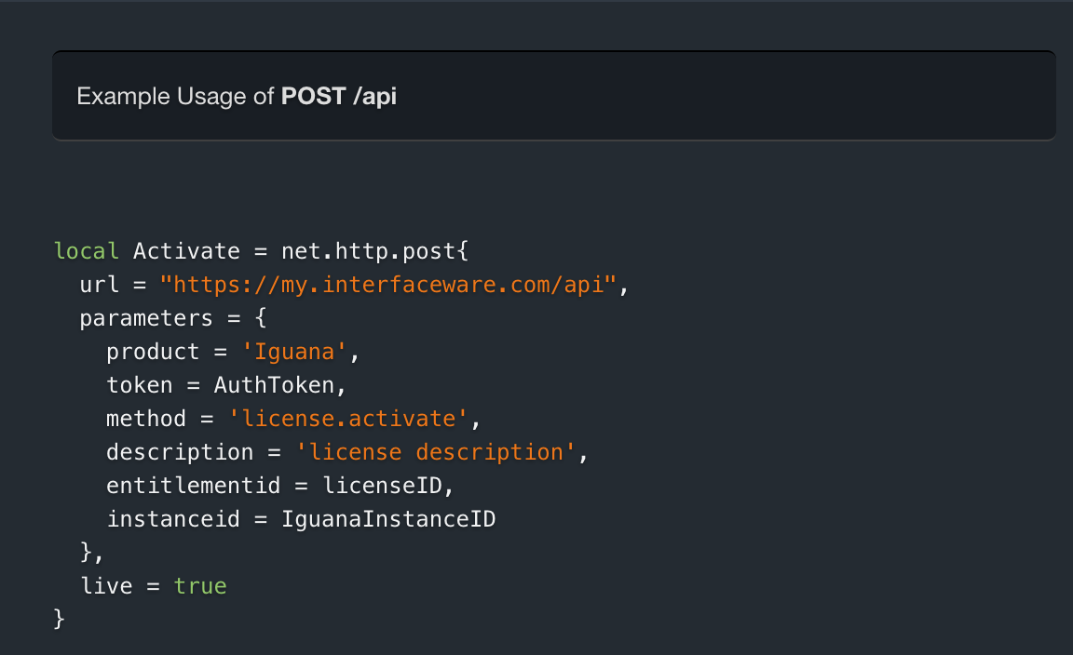
Licensing
License API
Get authorization token
Get list of licenses
Activate a license
Check if a license is activated
Transfer a license
Get instance details
Apply license
Notes:
Provides a license description (e.g. Base, Professional or Enterprise License) and code

Slide 26
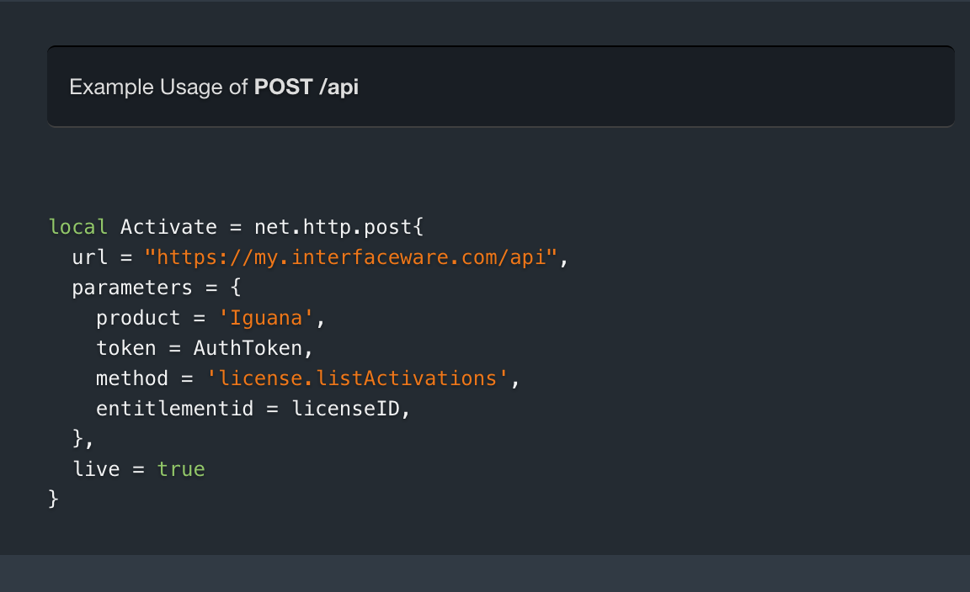
Licensing
License API
Get authorization token
Get list of licenses
Activate a license
Check if a license is activated
Transfer a license
Get instance details
Apply license
Notes:
Check to see if a license is activated, and receive info

Slide 27
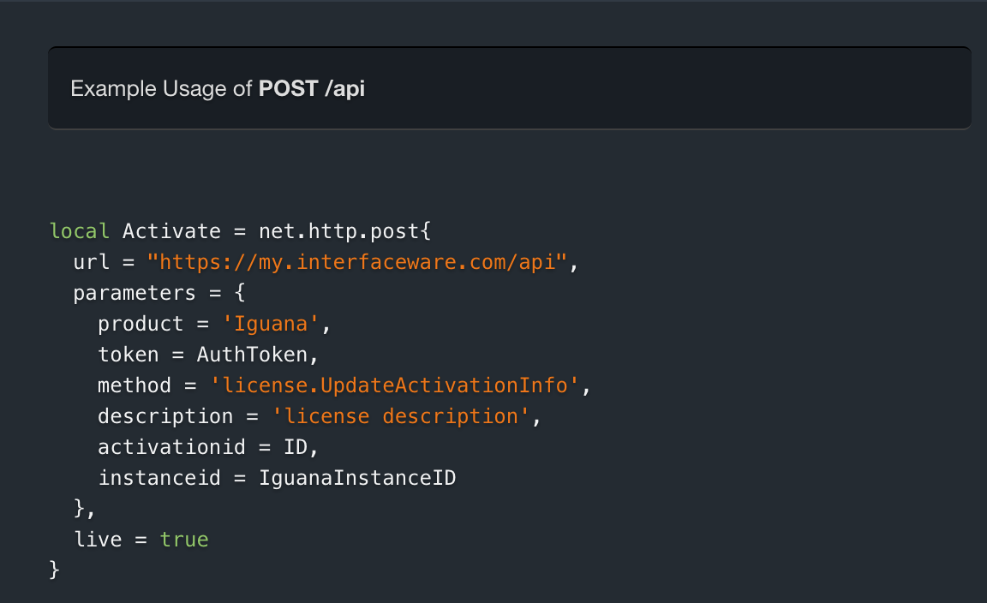
Licensing
License API
Get authorization token
Get list of licenses
Activate a license
Check if a license is activated
Transfer a license
Get instance details
Apply license
Notes:
Transfer a license by stating Activation ID
and the ID of the instance you’re transferring to.

Slide 28
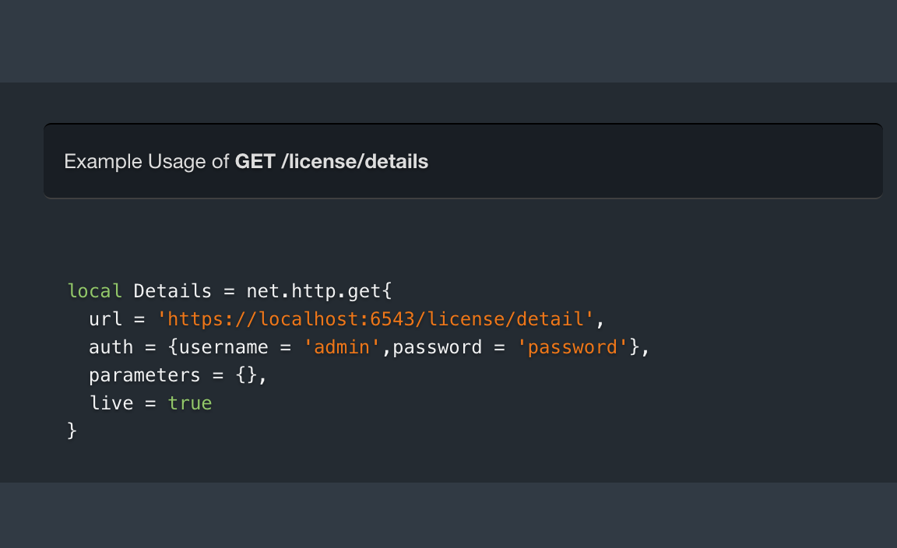
Licensing
License API
Get authorization token
Get list of licenses
Activate a license
Check if a license is activated
Transfer a license
Get instance details
Apply license
Notes:
Details: instance ID, for transferring a license

Slide 29
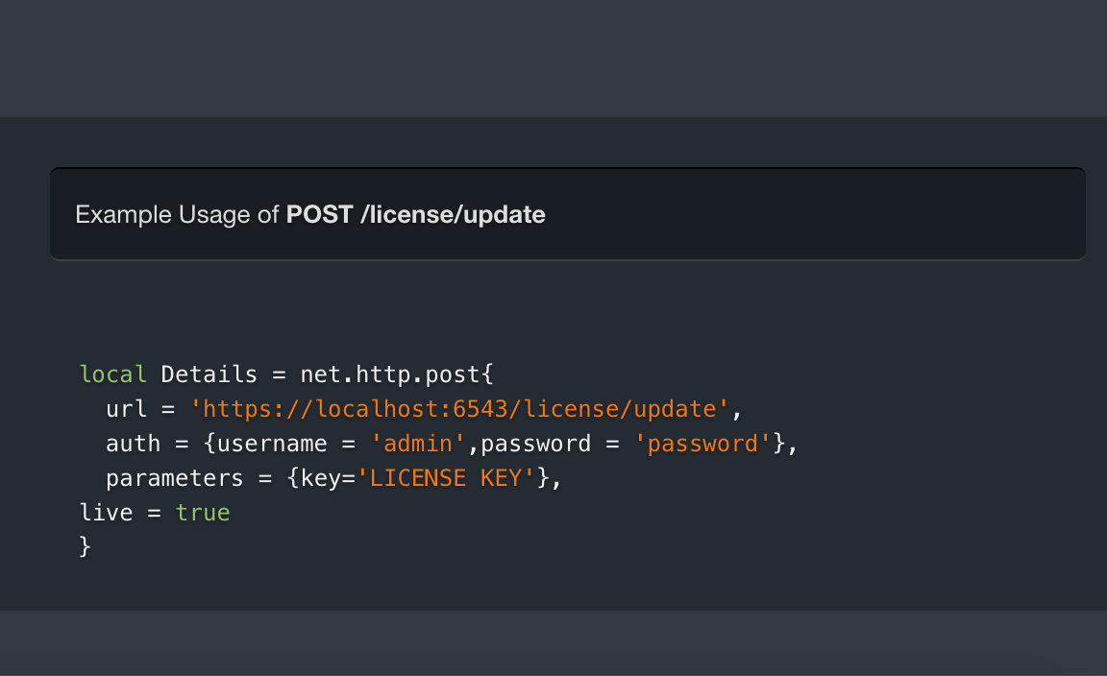
Licensing
License API
Get authorization token
Get list of licenses
Activate a license
Check if a license is activated
Transfer a license
Get instance details
Apply license
Notes:
Apply code by stating the license key
Dynamically activate Iguana without having to manually access the application.

Slide 30
Licensing
License API Benefits
Faster Deployment . Greater Security . Limit Risks
Notes:
Fast deployment , limiting the potential for human error
Administration webinar, call this API externally, each type of license-based activity.

Slide 31
Licensing
Survey!
Notes:
Pull up License Poll

Slide 32
DEPLOYMENT

Slide 33

Deployment
Notes:
User Sync:
Configuring user roles and permissions manually

Slide 34

Deployment
Did You Know?
User Synchronization

Slide 35
Deployment
Did You Know?
User Synchronization

Slide 36
Deployment
Did You Know?
User Synchronization

Slide 37
Deployment
Did You Know?
User Synchronization
Notes:
Master Iguana Server = replicate configuration to all other Iguanas - running identical versions

Slide 38
Deployment
User Sync Benefits
Sync Programmatically . Reduce Efforts . Save Time
Notes:
Sync programmatically, save time for config
Administration webinar, = synchronize users, important caveats

Slide 39
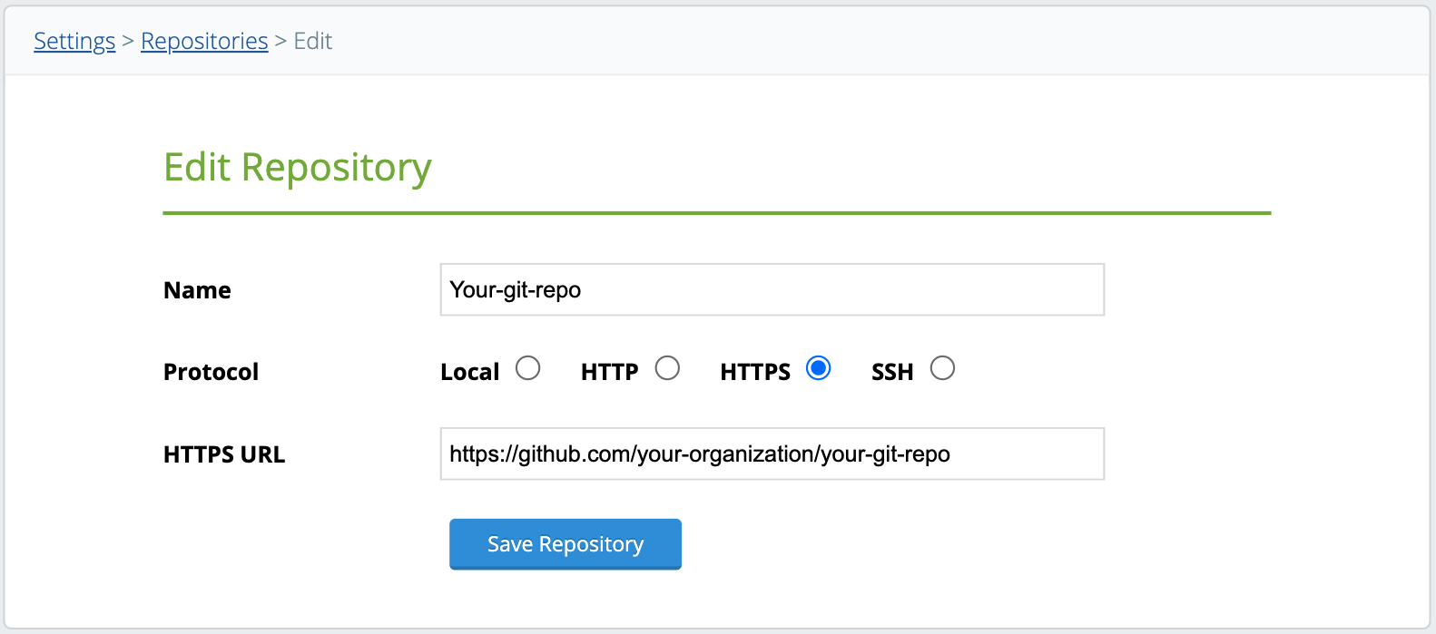
Deployment
Repositories
Notes:
Password:
import and export process = repository (for example Github).

Slide 40
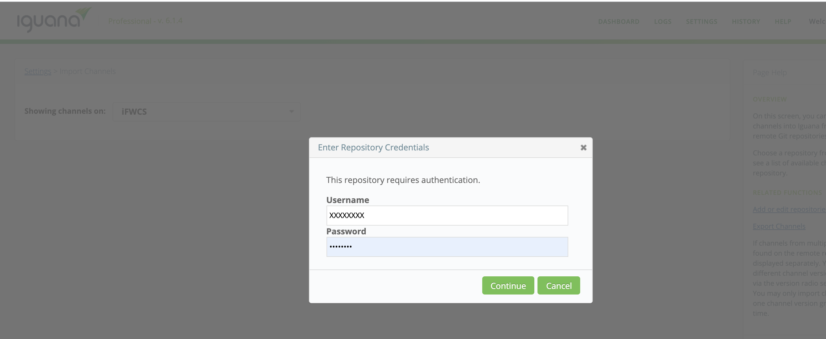

Deployment
Repositories
Notes:
Access via username and password.

Slide 41
Deployment
Repositories
Notes:
Multiple security risks, including brute-force and phishing attacks
Randomly-generated password can be difficult for users to remember
Did You Know? Iguana can help to make your authentication processes much more secure = SSH workflow

Slide 42



Deployment
Did You Know?
SSH Tunnels
Initiate session request
Sends server public key
Sends session key
Server decrypts session key
Request encrypted authentication
Client
Server
Notes:
Strong data encryption
User and Host Authentication
Message Authentication
Handshake process using SSH keys between an Iguana Client, and a Server.

Slide 43
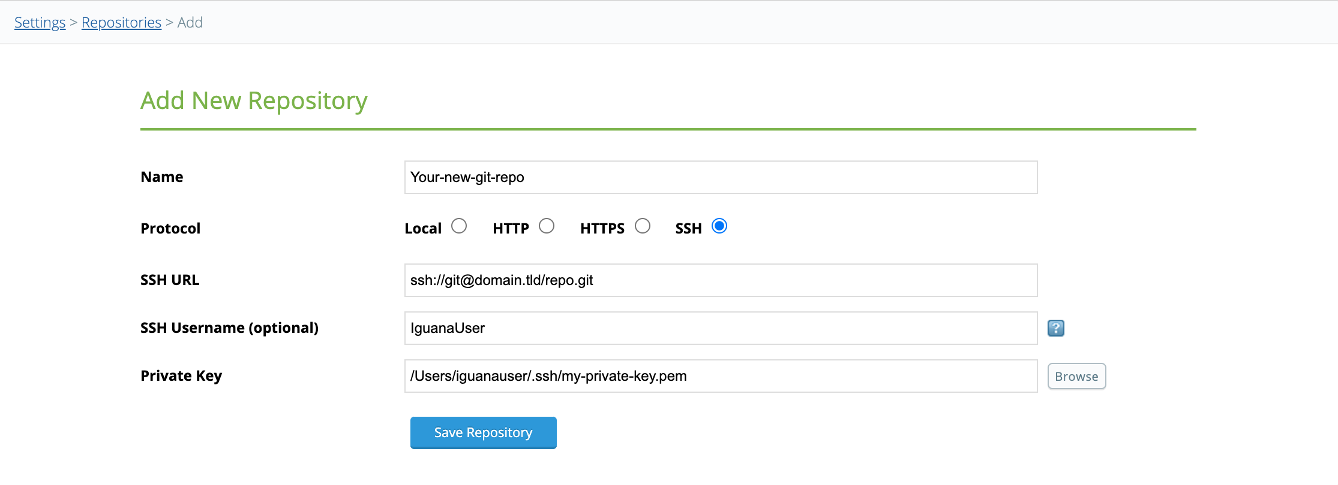
Deployment
SSH Integration
Notes:
Use private keys for authentication instead of a username and password

Slide 44
Deployment
SSH Benefits
Improved Security . Quick and Easy Repo Access . No Memorization
Notes:
Strengthen security standards = data encryption,
Easy access to repositories , no memory to input usernames and passwords.
GitHub - August 13, 2021, they’ll be using SSH keys or token-based authentication
Administration webinar, = setting up SSH in Iguana, how you can smoothly transition

Slide 45
UPGRADE
Notes:
Upgrade processes

Slide 46



Upgrade
Iguana Pro + Enterprise: Cloud friendly. More security options.
Improved scalability management
Iguana 6: Improved deployment workflows. Interface portability
Iguana 5: The Translator. Highly adaptable & extensible
Iguana 3 & 4: Message broker. Connect to file systems, DBs, web services
Chameleon: HL7 toolkit
Notes:
Chameleon, embedded into other software,
Iguana, stand-alone platform for transmitting and transforming messages.
Upgrade = maintain your business continuity, Iguana features, security updates, and integration trends.
Legacy Iguana hesitant to upgrade to the newest version due complexity of architecture

Slide 47
Upgrade
Did You Know?
Easy Upgrade Process
Iguana Pro + Enterprise: Cloud friendly. More security options.
Improved scalability management
Iguana 6: Improved deployment workflows. Interface portability
Iguana 5: The Translator. Highly adaptable & extensible
Iguana 3 & 4: Message broker. Connect to file systems, DBs, web services
Chameleon: HL7 toolkit
Notes:
Did you know there’s a simple, painless, no-fuss way to upgrade your instance?
Follow our best practice recommendations and considerations for the process

Slide 48
Upgrade
Did You Know?
Easy Upgrade Process
Backup your legacy Iguana
Copy over files
Run Iguana safely
Notes:
Backup legacy properly,
Legacy files you should and should not copy
Safely run Iguana for the first time

Slide 49
Upgrade
Upgrade Benefits
Leverage Enhancements . Improve System Stability . Support Business Growth
Notes:
Clean upgrade,
Latest Iguana enhancements,
Improve your system’s stability,
Support business growth.
Administration webinar = important tips for upgrading, how it differs for Iguana 3, 4, and 5.

Slide 50
MIGRATION

Slide 51


Migration
Notes:
Migrate = huge business implications

Slide 52
Migration
Did You Know?
Migration Processes
Notes:
Did you know you can choose between two approaches?

Slide 53
Migration
Did You Know?
Migration Processes
Notes:
Big Bang approach
2 environments.
During downtime
suitable for a migration of a few channels (10, 20, maybe 30).

Slide 54
Migration
Did You Know?
Migration Processes
Notes:
Staged = Migrate in phases

Slide 55
Migration
STAGES
1
4
New interfaces
2
3
Complex interfaces
Single interfaces
Pass-through interfaces
Notes:
Categories = can prioritize
First stage: New interfaces
Second stage: 1-off interfaces
Third stage: Pass-through interfaces
Last stage: Remaining and complex

Slide 56
Migration
Big Bang Benefits
Lower Cost . Faster ROI . Less Complexity
Staged Approach Benefits
Lower Risk . Easier to Manage . Minimal Downtime
Notes:
Advantages of the Big bang approach is that:
Less costly - incur the maintenance costs of a single system
Fast ROI = process changes happen immediately.
Less complicated, no temporary systems
The Advantages of the Staged approach is that:
It’s Less risky, mid-course corrections
Easier to manage, can stage budget and resources
Min downtime, in parallel until the migration is completed.

Slide 57
Migration
Migration Strategy Benefits
Clean Process . Reduce System Downtime . Avoid Challenges
Notes:
Clean migration process , reduce system downtime and avoid unnecessary challenges.
Admin webinar = technical requirements, which approach makes business sense

Slide 58
Migration
Survey!
Notes:
Pull up Migration Poll

Slide 59
CONFIGURATION
Notes:
Config management also important part of upgrade and migration

Slide 60
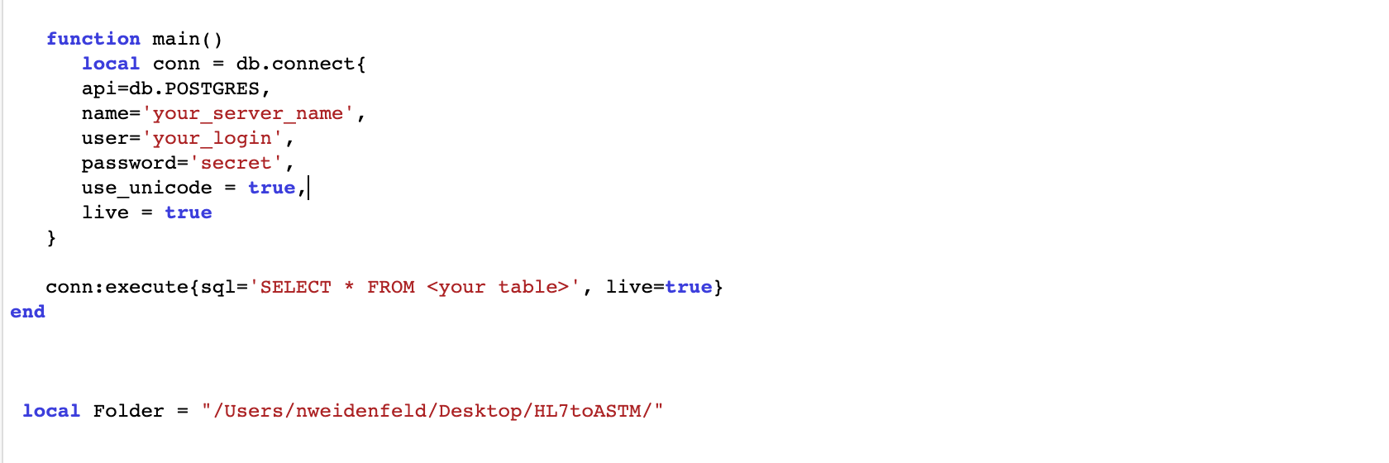
Configuration
Notes:
1. Usernames and passwords
2. Database host and name configurations
3. File directory locations

Slide 61
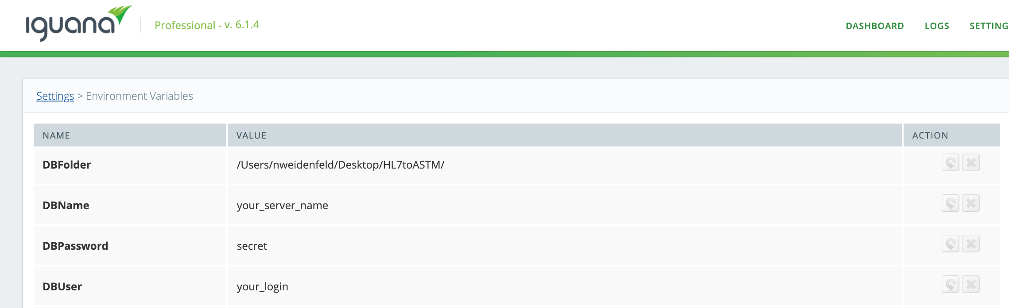
Configuration
Did You Know?
Environmental Variables
Notes:
No need to access the translator
Environmental variables
Assigned outside of the translator.
Settings page

Slide 62
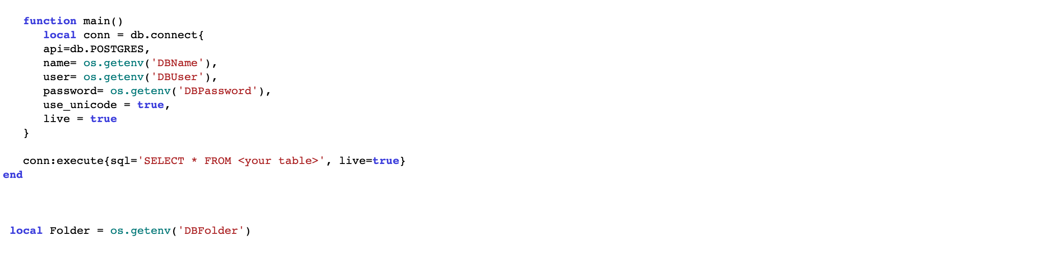
Configuration
Did You Know?
Environmental Variables
Notes:
“os.getenv"
Variable name is replaced with its assigned value.
No altering source code , testing process...

Slide 63
Configuration
Environmental Variable Benefits
Minimized Translator Access . Simplified Coding and Migration Processes
Notes:
No change in translator, limiting risk of human error.
IguanaEnv file located in the Iguana working directory
Easy to move and copy between instances,
Administration webinar=use cases for environmental variables

Slide 64
TROUBLESHOOTING
Notes:
You can troubleshoot proactively in Iguana

Slide 65
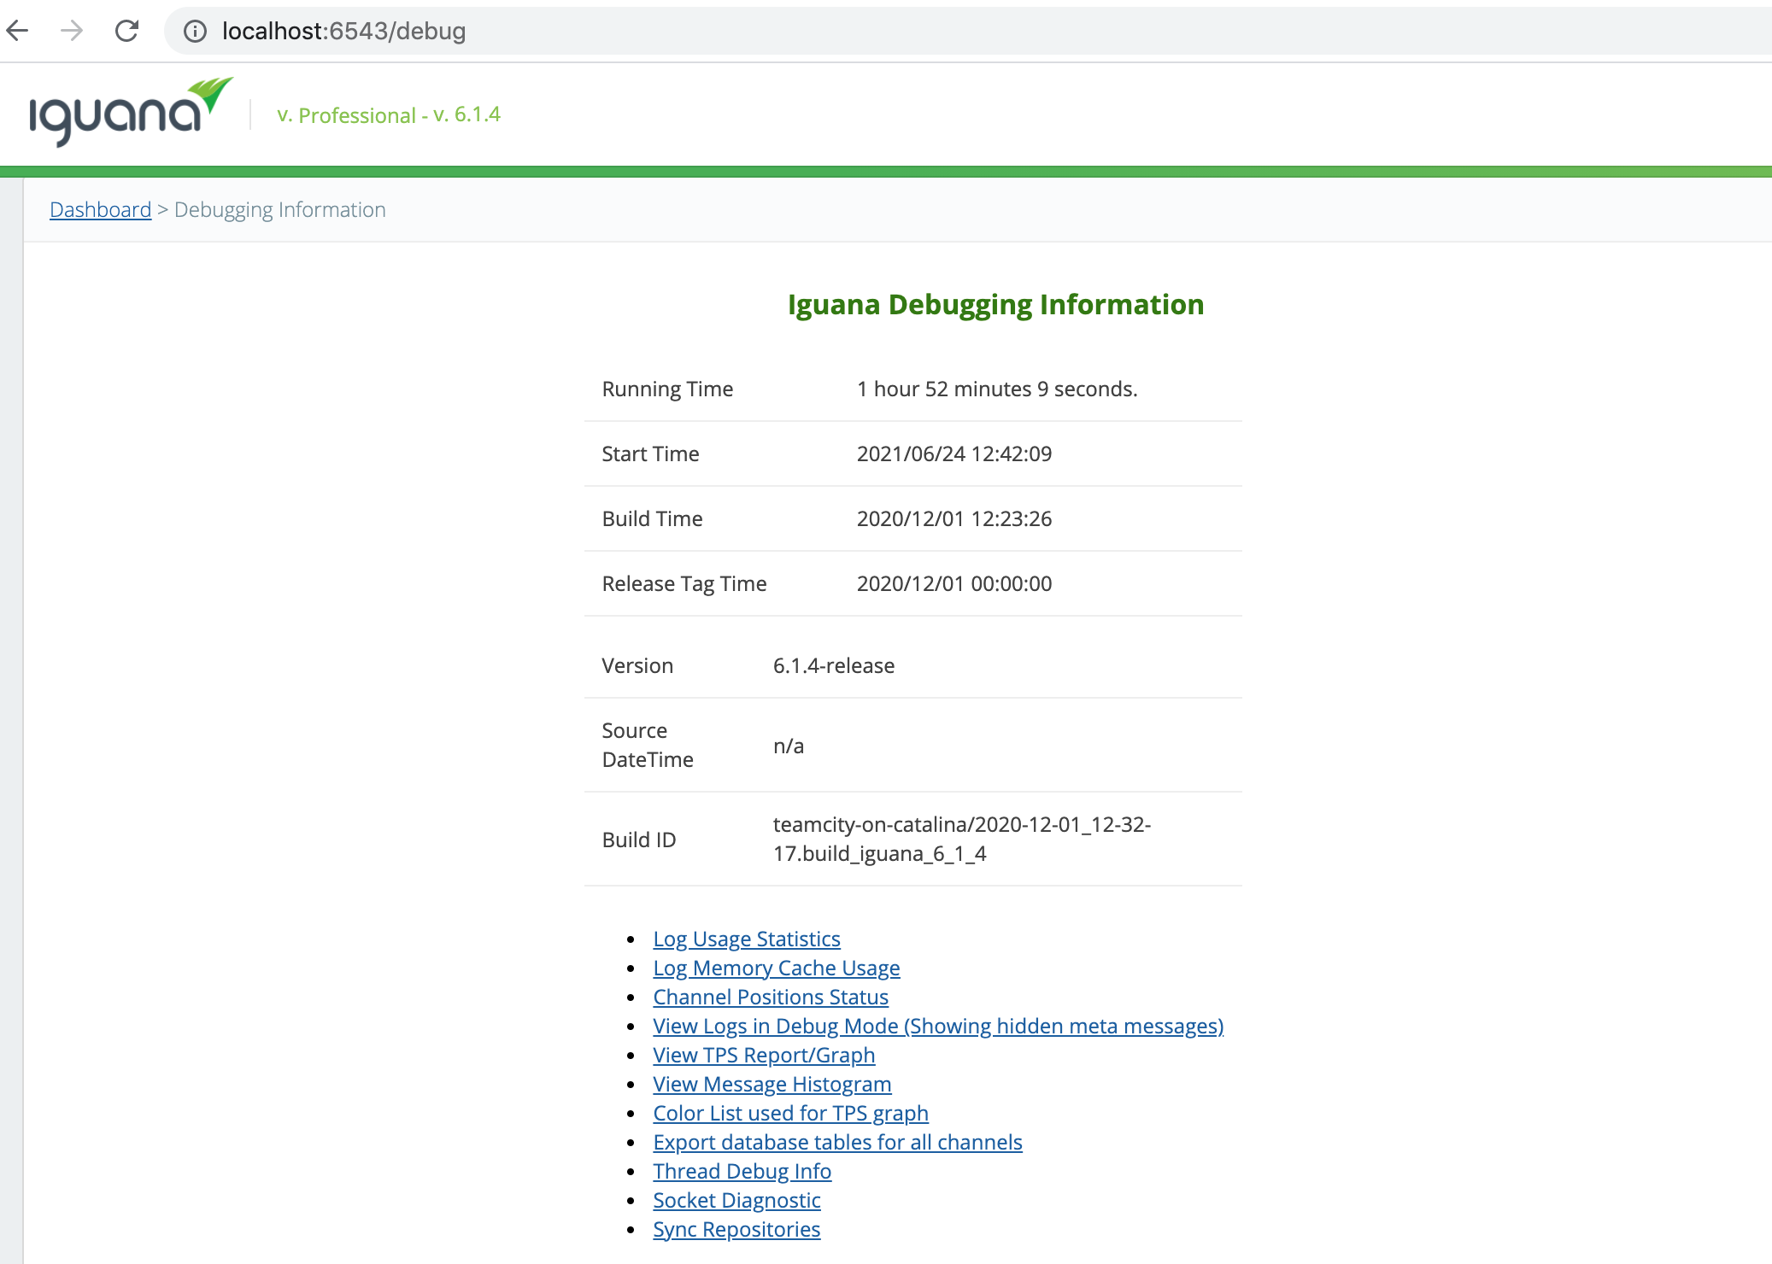
Troubleshooting
Did You Know?
Iguana Debug Dashboard
Notes:
Decline in your Iguana's performance.

Slide 66
Troubleshooting
Did You Know?
Iguana Debug Dashboard
Notes:
Log Usage Statistics.

Slide 67
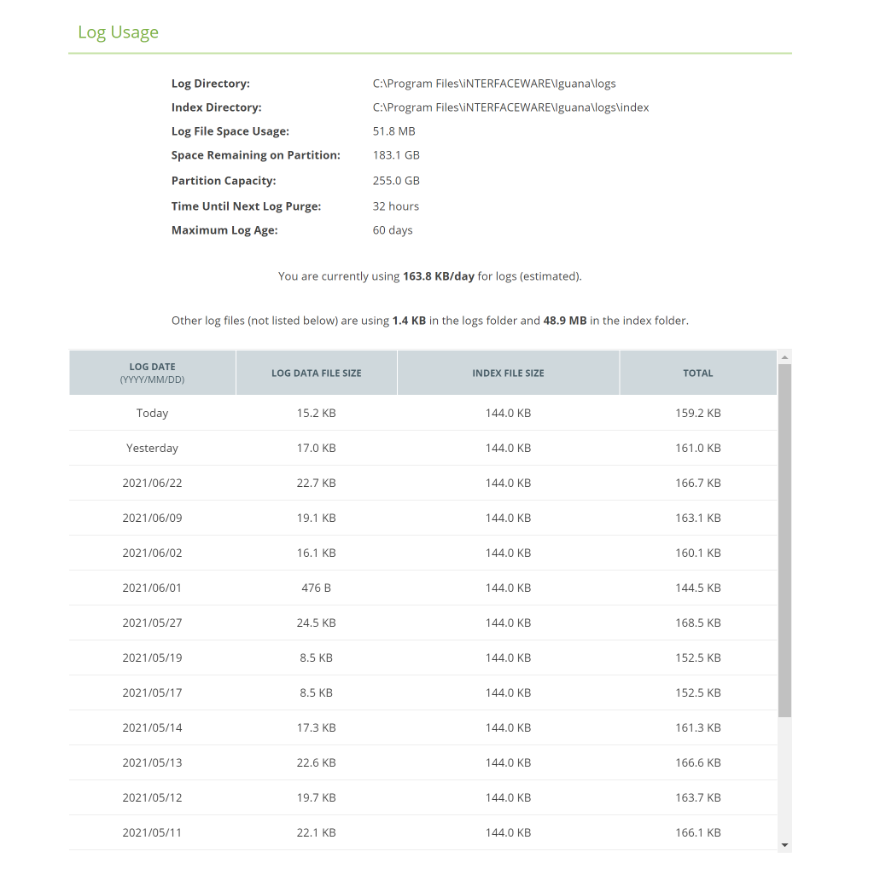
Troubleshooting
Log Usage Statistics
Notes:
View log stats, narrow down the cause
Some key things you can check are...

Slide 68
Troubleshooting
Log Usage Statistics
Notes:
Date of issue.

Slide 69
Troubleshooting
Log Usage Statistics
Notes:
Total log size

Slide 70
Troubleshooting
Log Usage Statistics
Notes:
The space remaining on the partition

Slide 71
Troubleshooting
Log Usage Statistics
Notes:
Partition Capacity

Slide 72
Troubleshooting
Log Usage Statistics
Notes:
And how many logs have been used per day.

Slide 73
Troubleshooting
Socket Diagnostic
Notes:
Socket diagnostics.
“Too Many Open Sockets” error

Slide 74
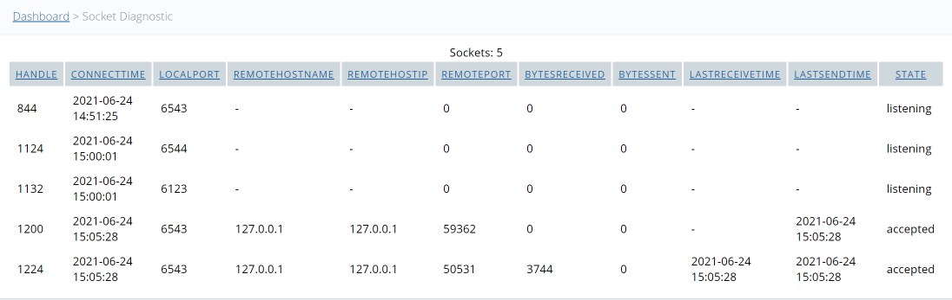
Troubleshooting
Socket Diagnostic
Notes:
All sockets that are used by Iguana
Hundreds of sockets listed here, sockets aren’t being closed properly.
Socket timeout needs to be reduced
Split up across several Iguana servers.

Slide 75
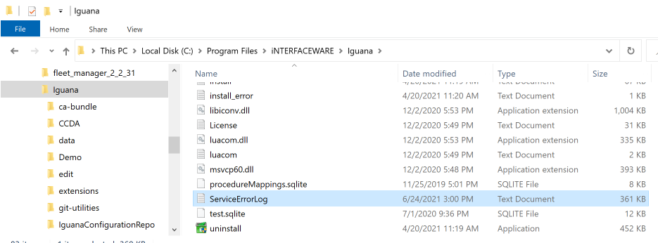
Troubleshooting
Service Error Logs
Notes:
Service error logs, which can be found in your Iguana Main Repo.

Slide 76
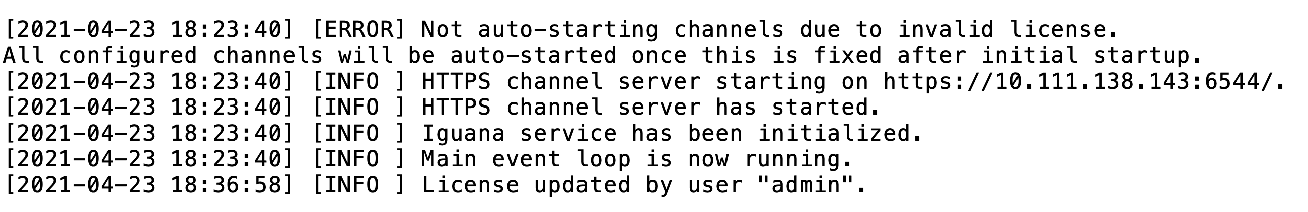
Troubleshooting
Service Error Logs
Notes:
Date and time of issues

Slide 77
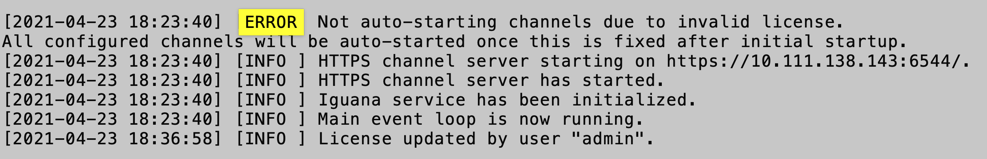
Troubleshooting
Service Error Logs
Notes:
searching for the word “Error”

Slide 78
Troubleshooting
Troubleshooting Benefits
Proactive Issue Resolution . Optimized Iguana Performance . Restore Business Productivity
Notes:
Identify issues proactively
Optimize performance
Restore your business productivity
Administration webinar = error resolution workflows, additional tools

Slide 79
SECURITY
Notes:
Ensure that the data flowing through your instances remains secure.
Built-in algorithms, cyber attacks

Slide 80

Security
Did You Know?
SSL Security
HTTP
Human readable data
Server
Client
HTTPS
Encrypted data
(not readable)
SSL Key
SSL Key
Server
Client
Notes:
In Iguana, there are two places you can set up SSL.

Slide 81
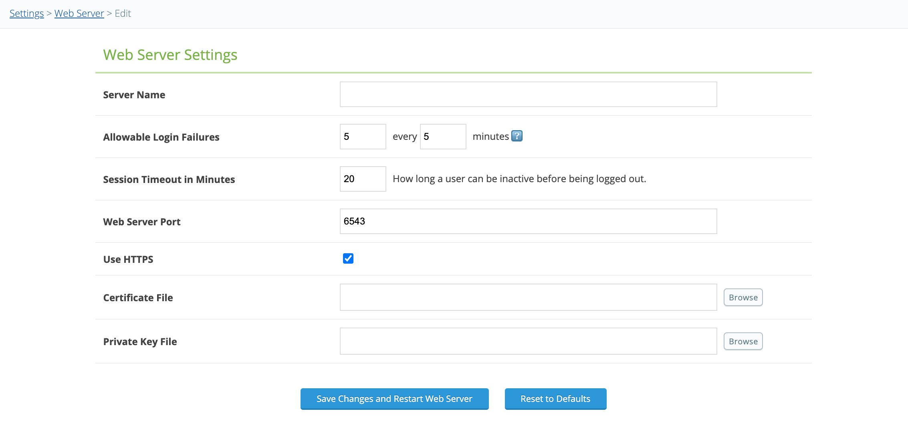
Security
SSL Settings
Notes:
Web Server Settings
Apply SSL to web-based APIs (e.g. our log or monitor API),
Dashboard , Acknowledgements that you receive from the web server.

Slide 82
Security
SSL Settings
Notes:
Public/private key certificates,
Certificate file
Input and restart web server to apply.

Slide 83
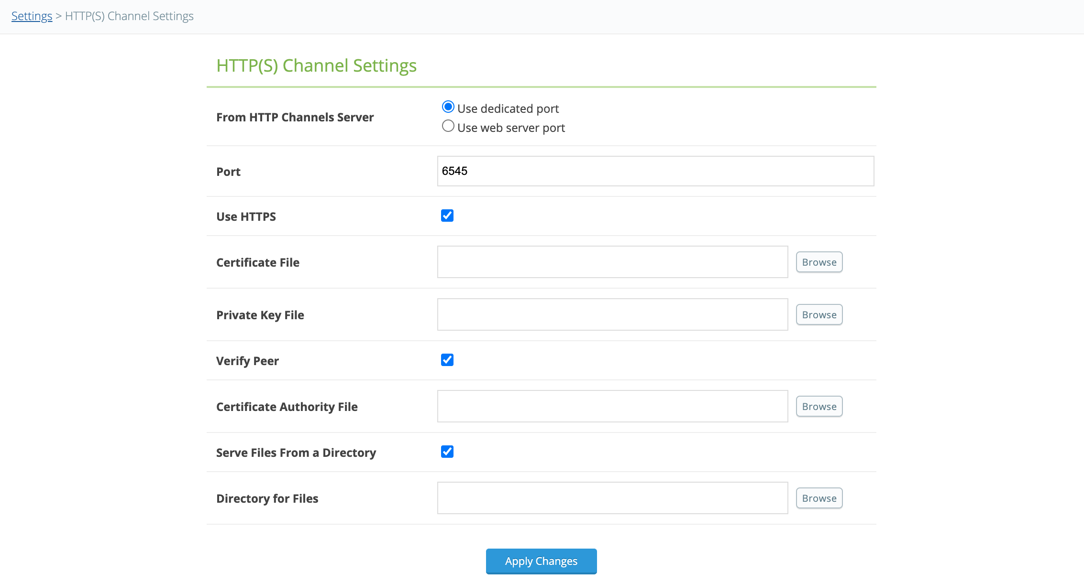
Security
SSL Settings
Notes:
HTTPS Channel Settings
Two-way SSL authentication.

Slide 84
Security
SSL Settings
Notes:
Verify Peer, verify the server sending you messages.

Slide 85
Security
SSL Settings
Notes:
Serve Files from a directory: embedded content (images).
PHI or other sensitive data, recommend applying these to fully protect your data
HIPAA

Slide 86




Security
Private Network
Internet
Client
Reverse proxy
Server
Notes:
Expedite processes for password-protected workflows

Slide 87
Security
Did You Know?
Reverse Proxy with SSO
Private Network
Internet
Client
Reverse proxy
Server
Notes:
Proxy Server - reverse proxy with Single Sign On
Gateway between a client and a web server.

Slide 88
Security
Private Network
Internet
Client
Reverse proxy
Server

Slide 89

Security
Identity provider
Private Network
Internet
Client
Reverse proxy
Server
Notes:
When applying SSO
Identity Provider System, validate before
No need to re-enter their access credentials
Communication
Faster, more efficient, and more secure

Slide 90
Security
SSL and Reverse Proxy Benefits
Meet Compliance Requirements . Enhance Data Security . Expedite Workflows
Notes:
Meet security compliance requirements, Enhance your data security, and expedite your workflows
Administration webinar = configure Iguana to implement secure workflows

Slide 91
PERFORMANCE

Slide 92
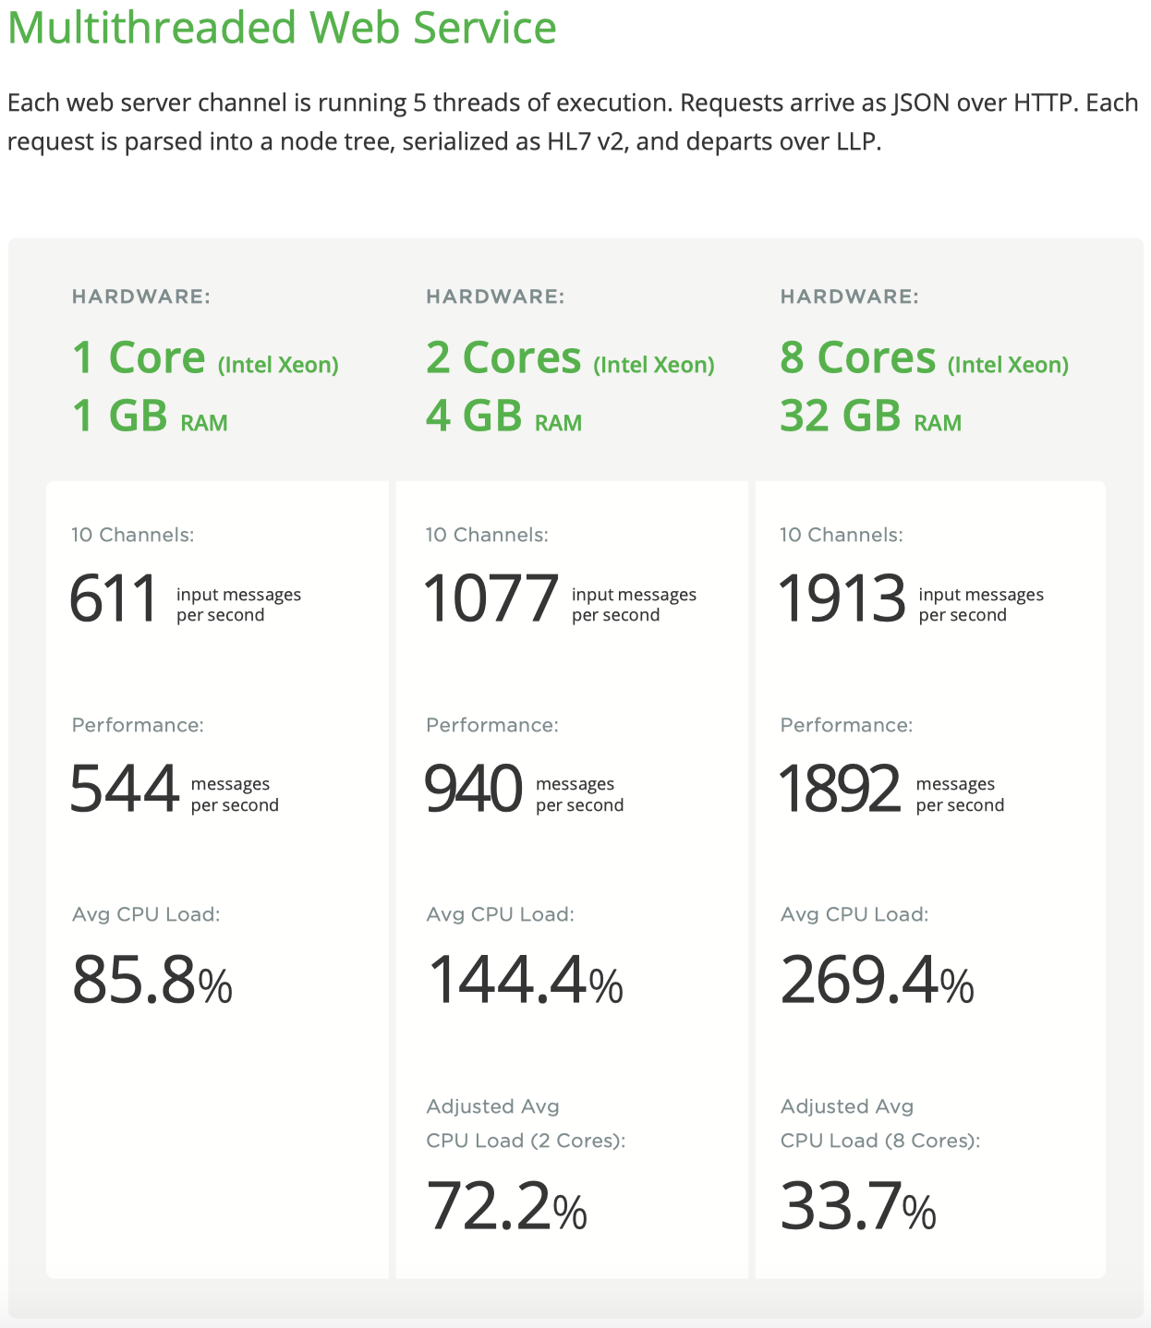
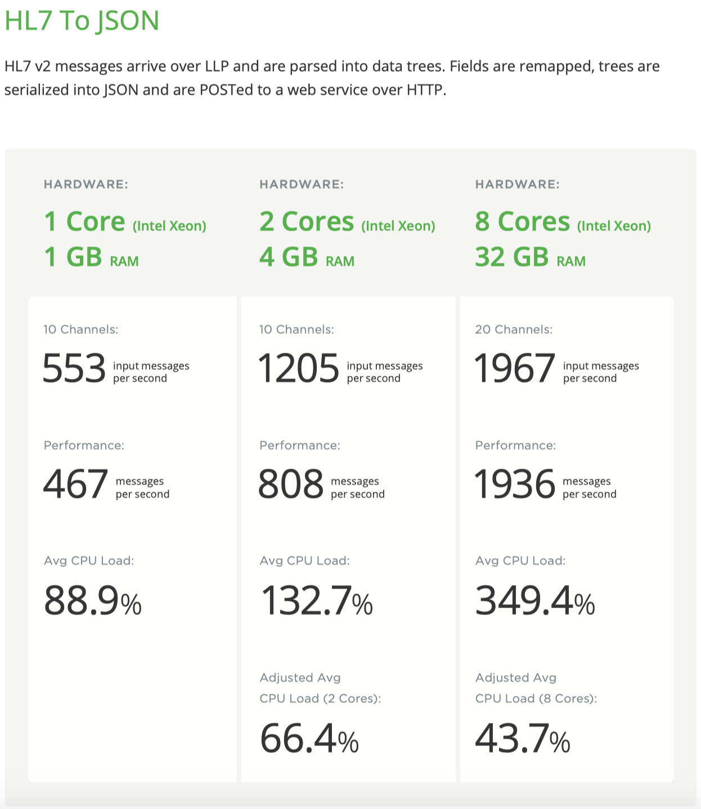
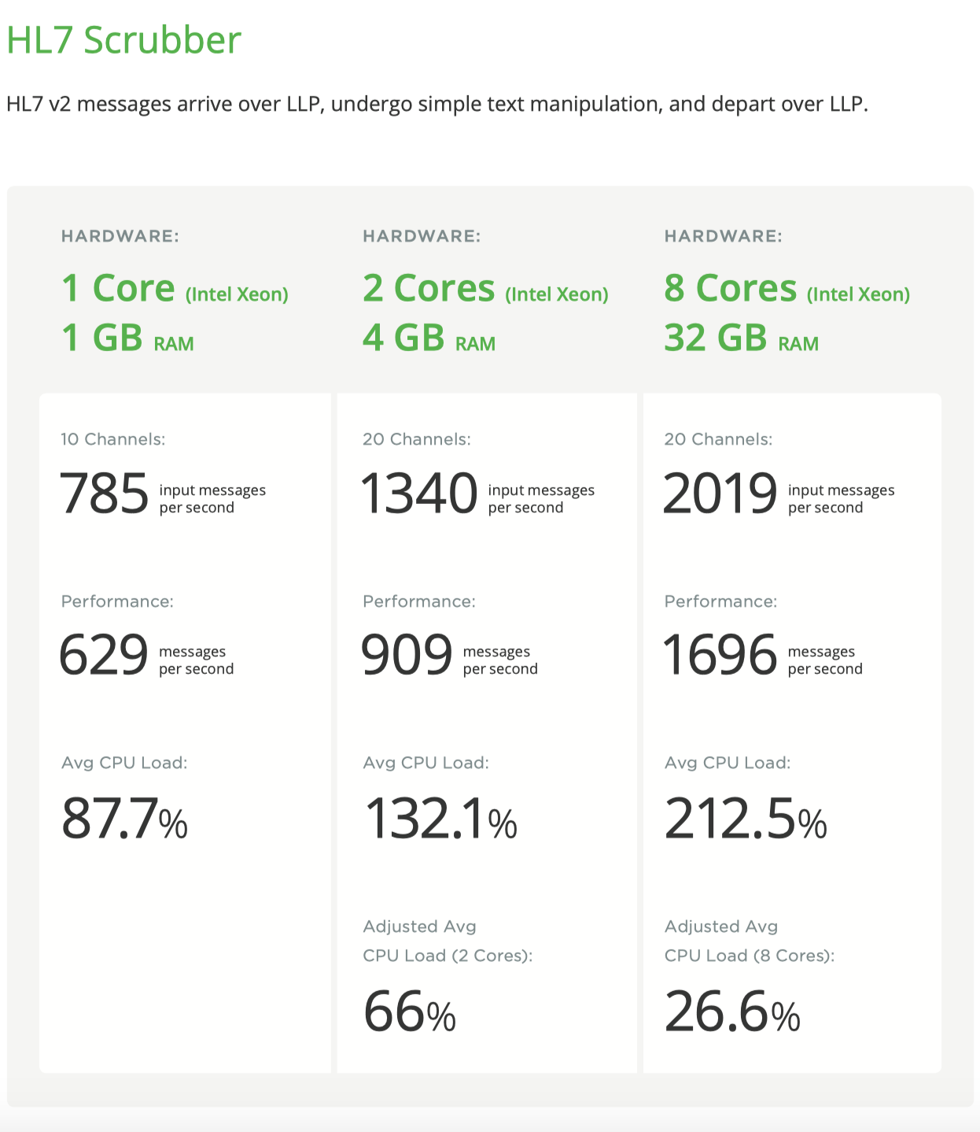
Performance
Notes:
Processing speed, stability, and scalability,
Indicate changes for data processing improvement.
Performance - top-of-mind concern
Performance tests before each major Iguana version release.

Slide 93
Performance
Did You Know?
Internal Performance Testing
Notes:
Conduct internally

Slide 94
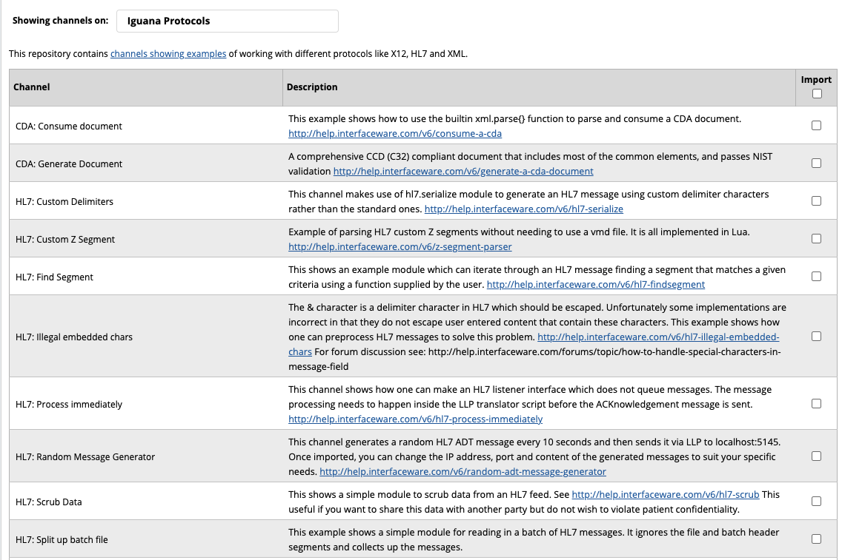
Performance
Performance Testing Tools
Notes:
Messages per second
Checking your CPU usage
Access to channels...

Slide 95
Performance
Performance Testing Tools
Notes:
HL7 random message generator creates HL7 messages
In Iguana channel form.
Based on translator functionality
Can change code (500 messages a second, 1000 messages a second, etc)

Slide 96
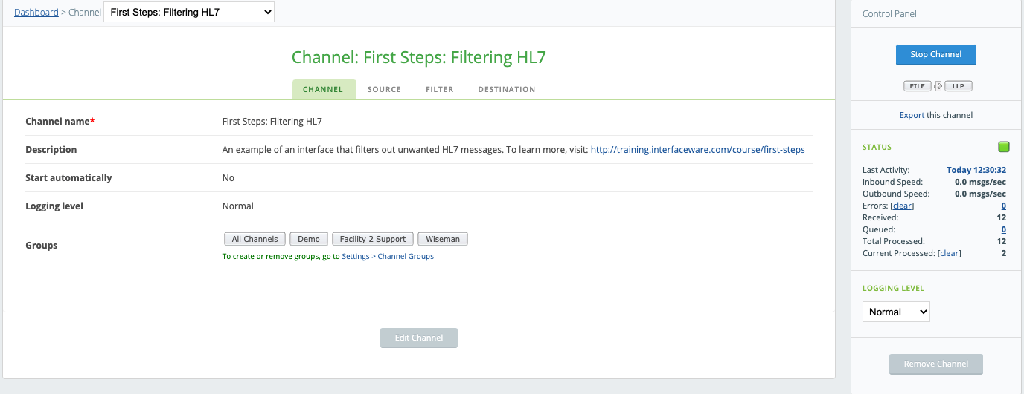
Performance
Performance Testing Tools
Queued Message Count
Processed Message Count
Processing Speed
Notes:
Channel level
How many messages have been queued, how many have been processed, the speed of processing etc.

Slide 97
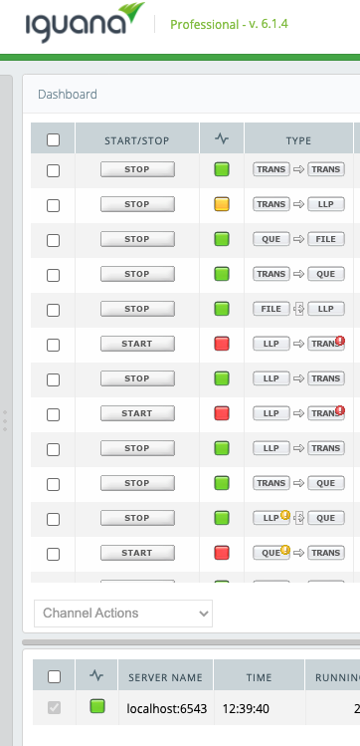
Performance
Performance Testing Tools

Slide 98
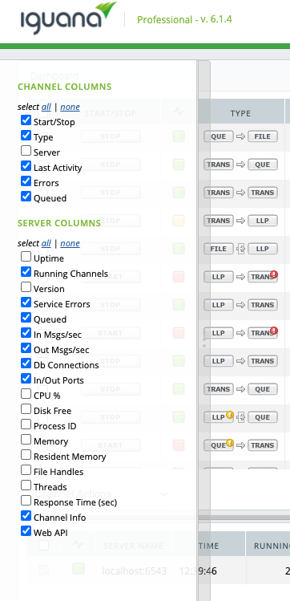
Performance
Performance Testing Tools
CPU Usage
Response Time
Memory Usage
Disk Free
Notes:
CPU usage, response time, memory usage, etc.
administering Iguana, justifying server hardware upgrades,
adjust your hardware requirements accordingly.

Slide 99
Performance
Internal Performance Testing Benefits
Troubleshoot Proactively . Calibrate Hardware . Avoid Performance Bottlenecks
Notes:
Be proactive in troubleshooting
Adjusting your hardware requirements
Avoid performance bottlenecks.
Administration webinar, more tools and features
internal performance testing workflows.

Slide 100
INTERFACE DESIGNS

Slide 101
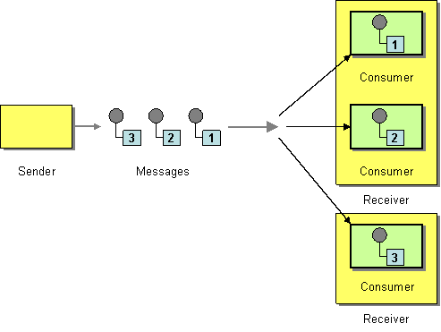
Interface Designs
Did You Know?
Industry-Tested Designs
Competing Consumers
Highly variables volumes
Parallel message processing
Highly available architecture
Notes:
Industry-tested interface designs - can optimize your interface architectures
Competing Consumers design – receiver channel, consumer channels.
Avoid Bottlenecks.
Use:
Handle peak message volumes
When volumes are highly variable, messages are independent, need to be highly available and remain resilient
E.g. payment processing workflows

Slide 102
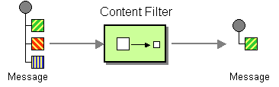
Interface Designs
Content Filter
Remove message elements
Transmit essential data
Notes:
Content filter design
Removing sensitive data
E.g. HL7 ADT messages, demographic and facility visit
Demographic information for scheduling purposes
Send PID segment downstream

Slide 103
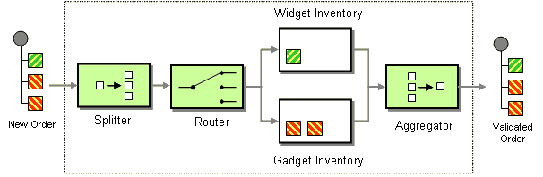
Interface Designs
Composed Message Processor
Inconsequential message order
Multiple message components
Individual processing requirements
Notes:
Composed Message processor design – splits the message up, routes the re-aggregates responses
Use:
order of results don’t matter, several components with their own processing requirements.
E.g. Orders workflow: medical device and prescription medication
Device inventory system,
Pharmacy system to fulfill.
Order filled, aggregated back into summary message

Slide 104
Interface Designs
Interface Design Benefits
Optimized Interfaces . Repeatable Solutions . Increased Reliability
Notes:
Optimize message processing activities, leverage for future issues, increase solution reliability,
”Developing Interfaces” webinar = more detail, use cases, optimize your architecture.

Slide 105
HIDDEN LUA COMMANDS
Notes:
Optimize the development process.

Slide 106
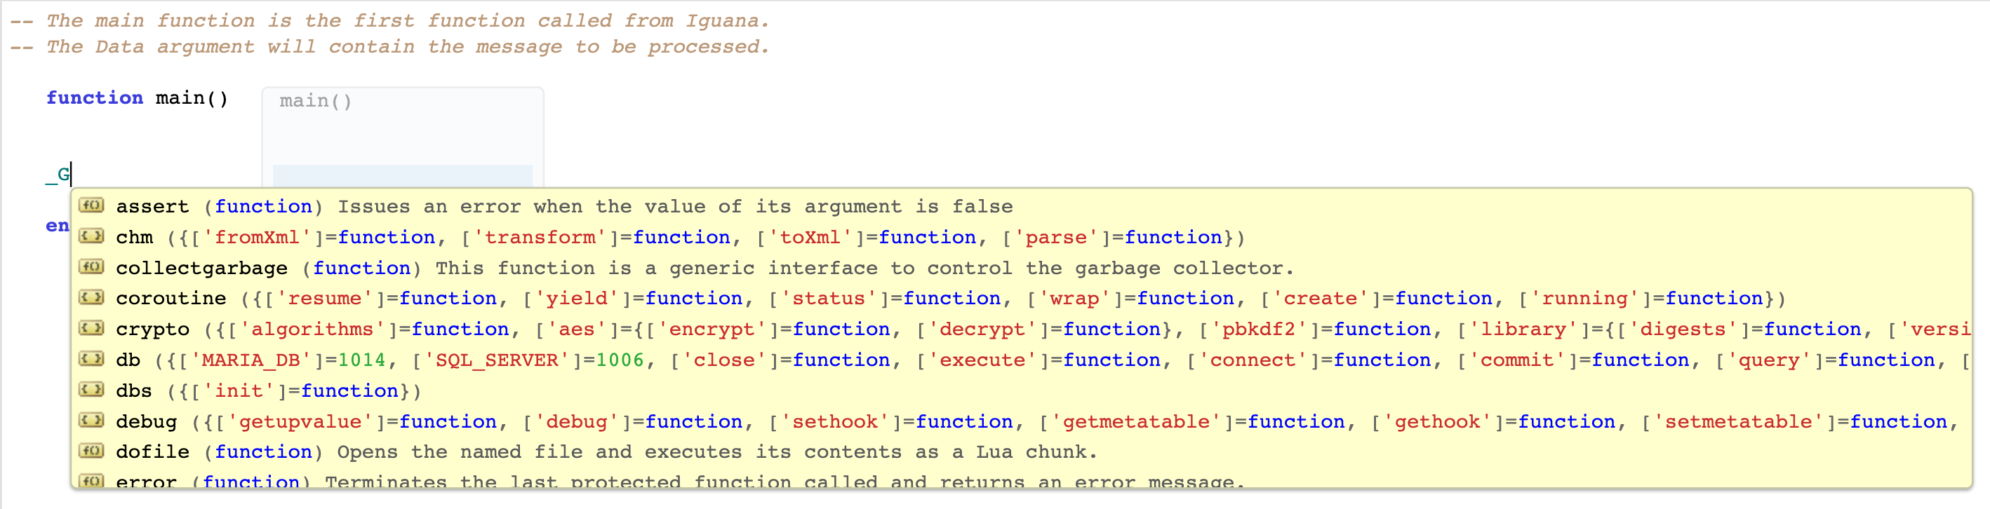
Hidden Lua Commands
Did You Know?
_G
Notes:
Hidden Lua commands you can call from the translator
“_G” = Lua context table, but values within this table can be used across scripts

Slide 107
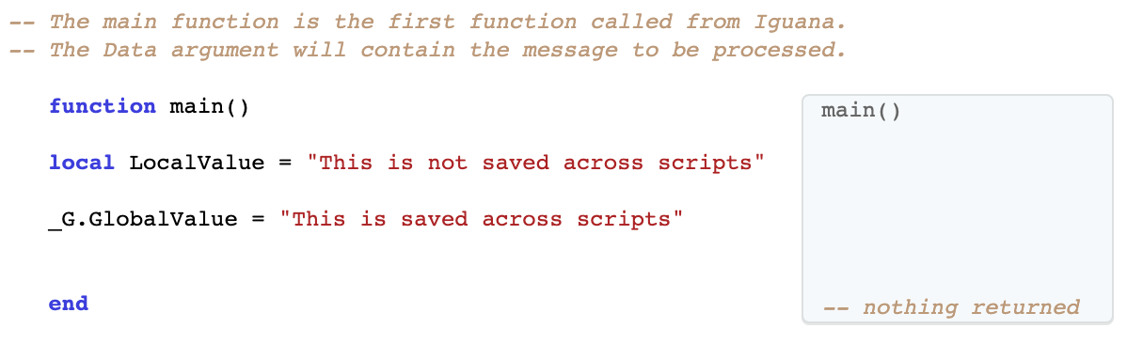
Hidden Lua Commands

Slide 108
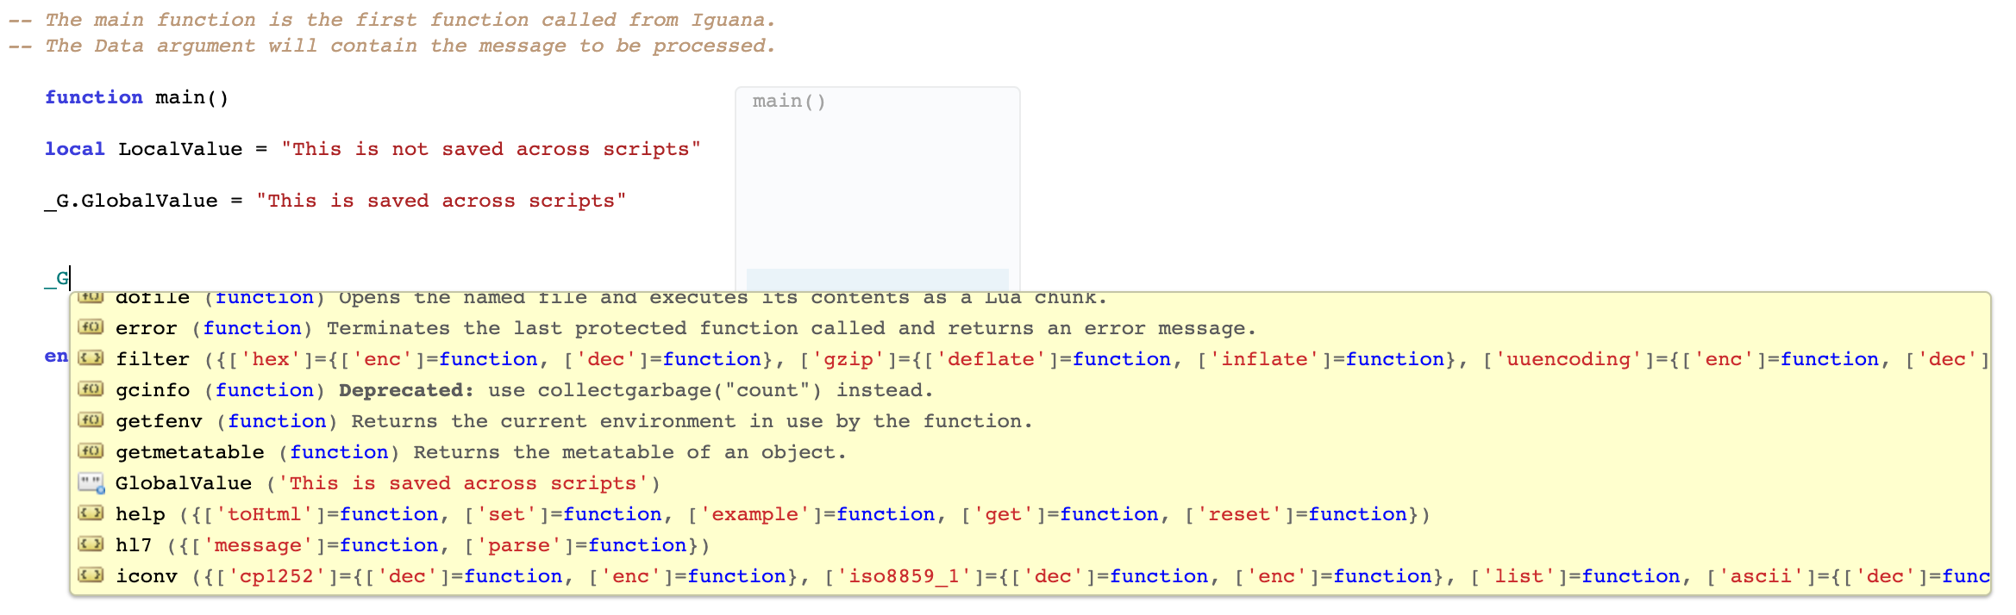
Hidden Lua Commands
Notes:
List of Iguana libraries and functions what can be done within each
Easier to browse functionality, store and manage variables in one place.

Slide 109
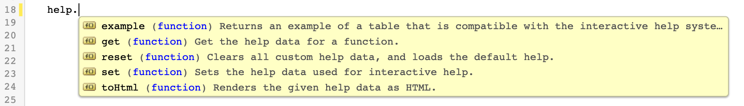
Hidden Lua Commands
Did You Know?
Custom Help Documentation
Notes:
Customized functions and modules
Did you Know? Create custom help documentation
Lua help function

Slide 110
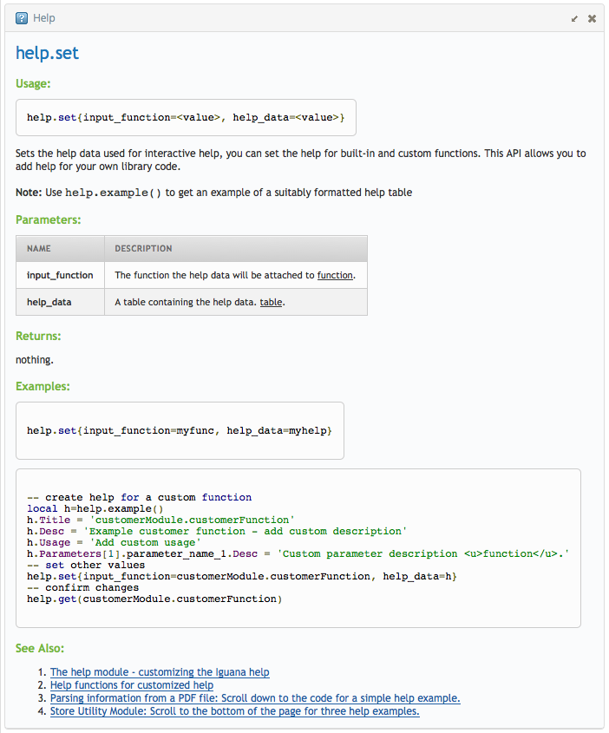
Hidden Lua Commands
Function title
Function description
Function usage
Required parameters
Notes:
help.set function:
Function title
Function Description
The Usage
And the required parameters.
User-facing functions, should define help, understand purpose

Slide 111
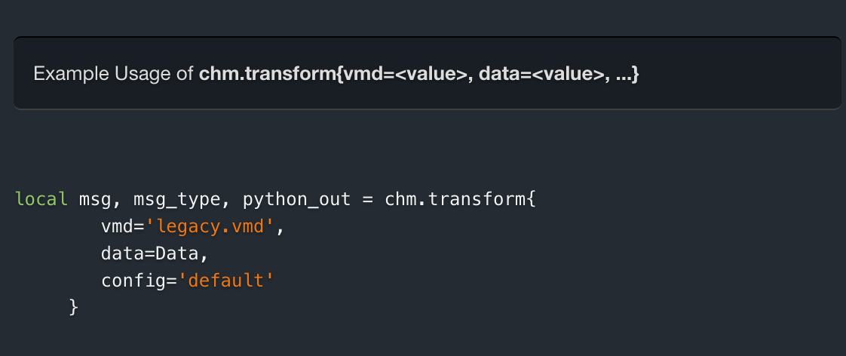
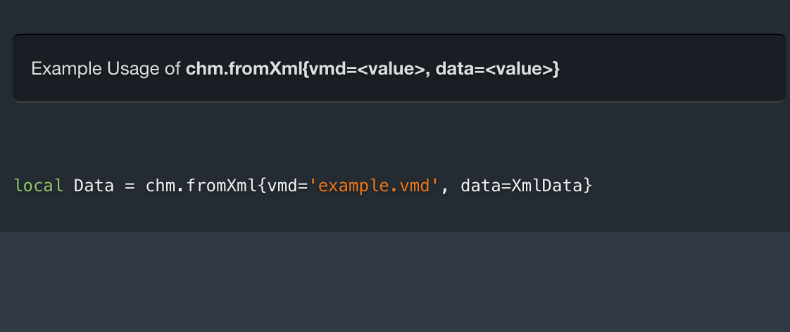
Hidden Lua Commands
Did You Know?
CHM API
CHM API
Convert HL7v2 XML into HL7
Invoke legacy parse using VMD
Converts HL7 into HL7v2 XML
Legacy VMD transformation
Notes:
Transition from Chameleon to Iguana.
Iguana provides tools to assist?
CHM API = convenience for Chameleon users switching to Iguana
“From Xml” function, converts XML string to HL7.

Slide 112
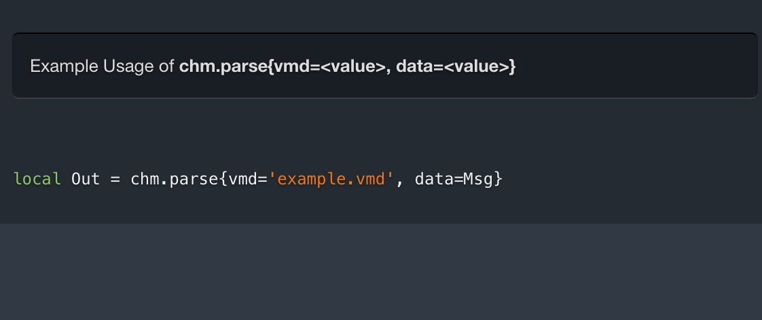
Hidden Lua Commands
CHM API
Convert HL7v2 XML into HL7
Invoke legacy parse using VMD
Converts HL7 into HL7v2 XML
Legacy VMD transformation
Notes:
“Parse” command, compare output of Chameleon interfaces to the equivalent Lua mapping code.
Parse and map your data according to your Chameleon VMD,
execute logic contained in VMD file’s Python scripts.

Slide 113
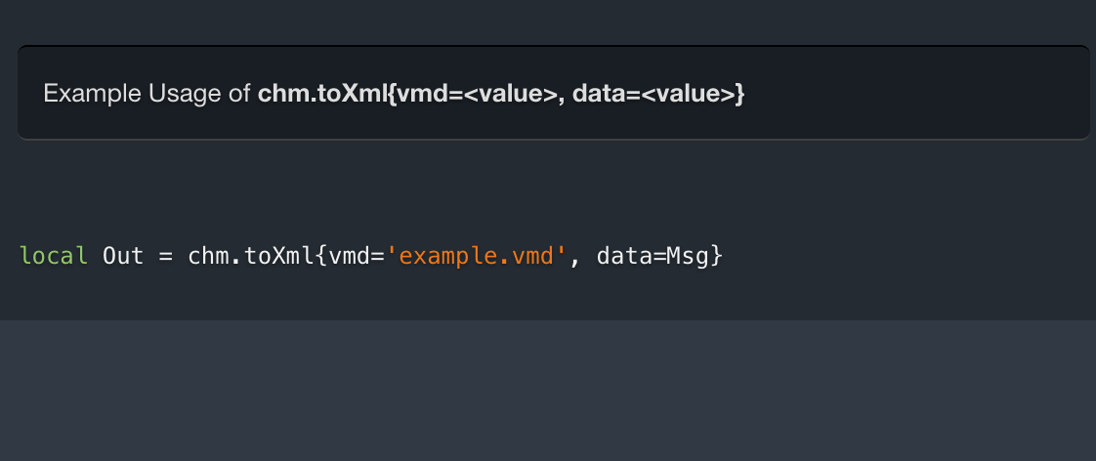
Hidden Lua Commands
CHM API
Convert HL7v2 XML into HL7
Invoke legacy parse using VMD
Converts HL7 into HL7v2 XML
Legacy VMD transformation
Notes:
“To XML” function, the reverse function of “From XML” command.
HL7 into XML string.

Slide 114
Hidden Lua Commands
CHM API
Convert HL7v2 XML into HL7
Invoke legacy parse using VMD
Converts HL7 into HL7v2 XML
Legacy VMD transformation
Notes:
“Transform” command, perform legacy transformation in Iguana similar Chameleon.
Convenient to compare output of the equivalent Lua mapping code.

Slide 115
Hidden Lua Commands
Hidden Commands Benefits
Improve Development and Upgrade Processes . Enhance Coding Procedures
Notes:
Improve interface development and upgrade processes
Enhance Iguana coding (better organize, create documentation).
Developing Interfaces webinar = use cases for these hidden commands, how you can apply

Slide 116
BEYOND HL7

Slide 117

Beyond HL7
Did You Know?
Support All Data Types
EDI
FHIR
HL7
DICOM
JSON
CDA
NCPDP
CCD
X12
ASTM
XML
Notes:
May not need a roster of different systems
Native processing capability, pre-built templates
sample data, in-house parsers, and common processing logic

Slide 118
Beyond HL7
Single System Benefits
Centralized Processes . Easier Management
Notes:
By having a single integration system that can ingest all of these data types, it means that all of your applications can connect to a central hub, so that your monitoring, deployment, and development processes are centralized and can be easily managed.

Slide 119
Beyond HL7
Survey!
Notes:
Pull up data type poll

Slide 120
DATABASES

Slide 121
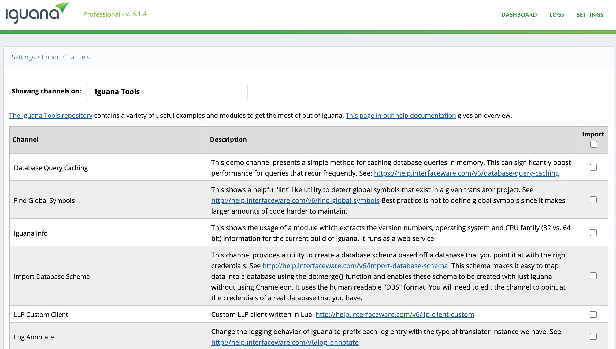
Databases
Did You Know?
Database Tools
Notes:
Database connection tools to enhance database maintenance, security and reliability
Import Database Schema tool to upload schema programmatically.

Slide 122
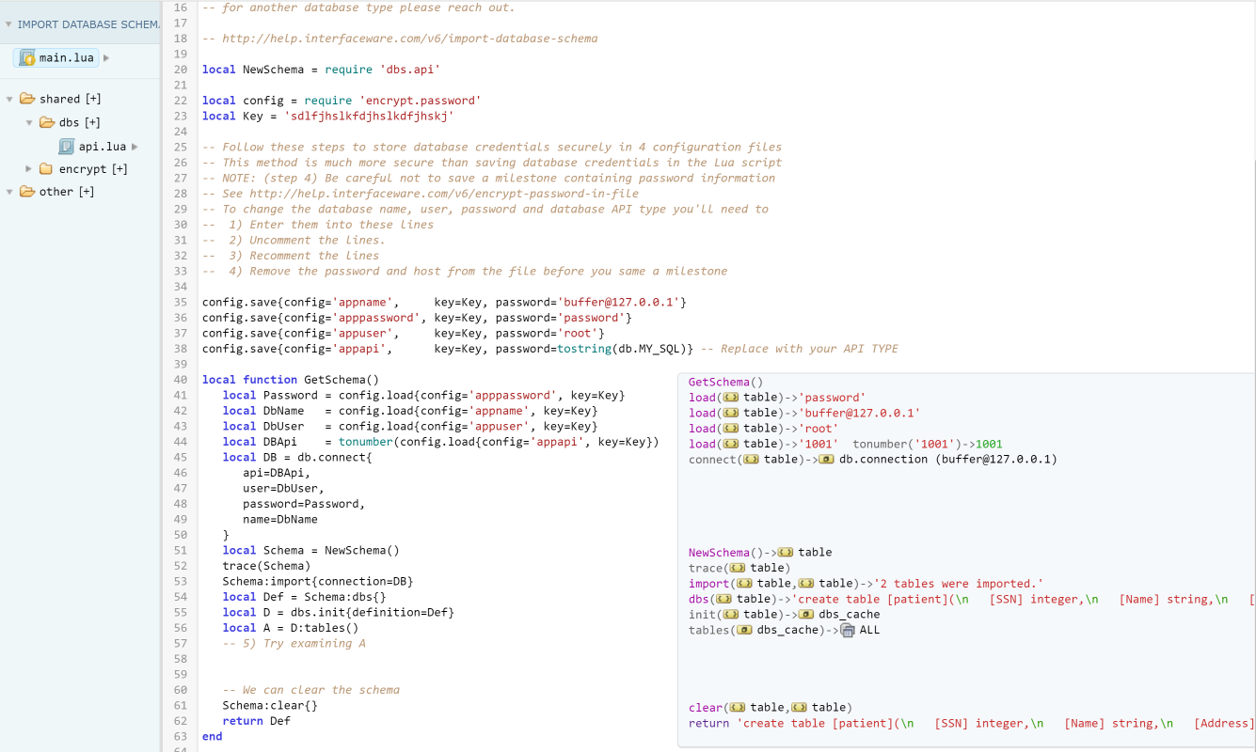
Databases
Import Database Schema Channel
Database Name
User Name
Password
API
Notes:
Input credentials
Database name, user name, password and API

Slide 123
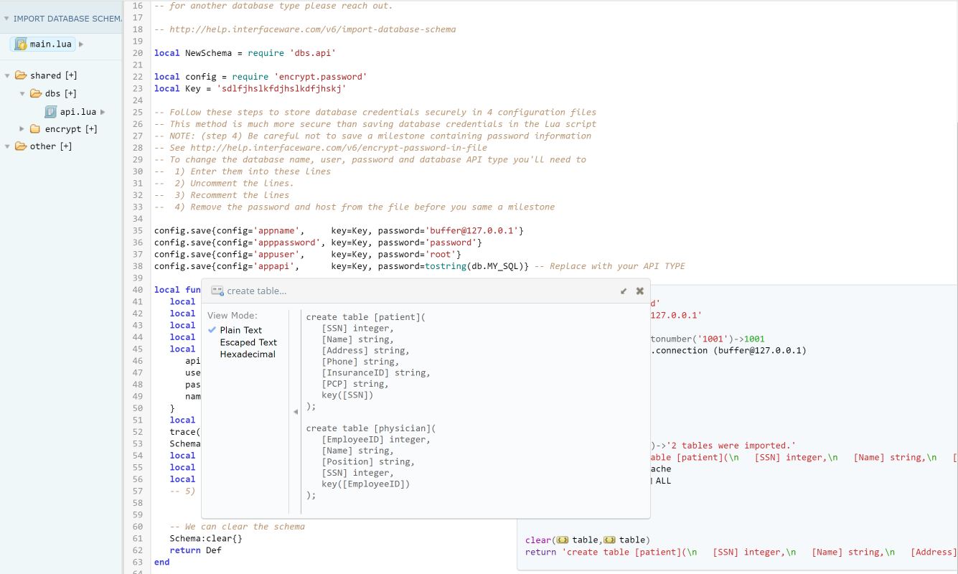
Databases
Import Database Schema Channel
Output table schema
Notes:
Output the table schemas

Slide 124
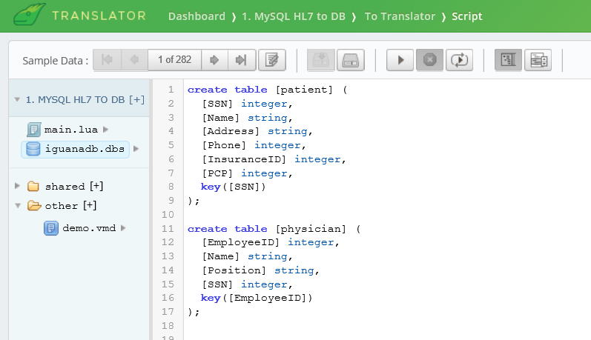
Databases
DBS Functionality
Copy schema into .dbs
Notes:
C&P into translator

Slide 125

Databases
DBS Functionality
Easily map and merge values
Notes:
Easily map values from data inputs.
Combine with merge function

Slide 126


Databases
Merging Data
Target Database
Data
LLP
TRANS
Application tables
Notes:
Best practices: don’t insert directly into app table

Slide 127

Databases
Merging Data
Target Database
Data
LLP
TRANS
Stagging tables
Application tables
Notes:
Staging table – temp data store
Added security so data not prematurely overwritten

Slide 128

Databases
DB2 Module
OPEN/CLOSE
Data
LLP
TRANS
Target Database
Notes:
Auto retrying connections.
Make 10 queries for single message
Best practice – close connections
Opening and closing connections many times for single message, affects performance, causes slowdowns
DB2 module

Slide 129

Databases
DB2 Module
Notes:
Built-in connection retry function.
Keep connection open
Resource intensive, what normally causes slowdowns

Slide 130
Databases
DB2 Module
Notes:
Core = DB module
More robust and reliable

Slide 131

Databases
DB2 Module
Notes:
Can be used as a handle
Has enhancements of DB2 module

Slide 132
Databases
Database Tool Benefits
Improve Maintenance . Enhance Security . Increase Reliability
Notes:
Improve database maintenance, security, and reliability procedures.
Developing Interfaces = tools and best practice recommendations for using them.

Slide 133
MODULES AND TEMPLATES
Notes:
Pre-built modules and templates.
EMRs, cloud-based services, and non-clinical apps.
Time consuming to create

Slide 134

Templates
Did You Know?
Pre-Built Templates
Notes:
Pre-built modules to quickly connect to these services
40% of the way there for connectivity and mapping development
Supported vendor EMR templates

Slide 135

Templates
Athenahealth:
Leverage built-in help documentation
Notes:
Easily connect to athenahealth's API, interact with available resources.

Slide 136

Templates
Athenahealth:
Leverage built-in help documentation
Notes:
Easier and faster way to recognize types of parameters in a web request + relevant description.

Slide 137

Templates
Athenahealth:
Leverage built-in help documentation
Notes:
Built-in help documentation for developing interfaces.

Slide 138

Templates
Notes:
We also have templates for

Slide 139

Templates
Notes:
EPIC

Slide 140

Templates
Notes:
Allscripts

Slide 141

Templates
Notes:
eClinicalWorks

Slide 142

Templates
Notes:
Amazon S3

Slide 143

Templates
Notes:
HL7 FHIR

Slide 144

Templates
Notes:
Smart on FHIR.

Slide 145

Templates
Notes:
And Salesforce

Slide 146
Templates
Pre-Built Template Benefits
Simplified Integration . Reduced Development Effort . Accelerated Implementation
Notes:
Templates save time and resources
No need to develop connections/mapping structures from scratch
Cut down implementation time
Solutions and Workflows webinar = introduce more templates, how to use within your business context.

Slide 147
THANK YOU!
Notes:
See you at our remaining 3 webinars: Solutions and Workflows. Iguana Administration and Configuration, Interface Development,

